Slide 1


A Construction Company Project Prepared by (Group - 1)
Youssef Mahmoud Saad
Tamer Nabil Essawi
Mohamed Fawzy Abdelfattah
Israa Ahmed Mahmoud
Soad Said Ameen
Osama Sayed Abdullhameed
Under Supervision of
Instructor: Mohamed Abdelrehim

Slide 2



CONSTRUCTION COMPANY
WAREHOUSE & PROCUREMENT
MODULE IMPLEMENTATION
Optimizing Procurement and Inventory for Business Growth
Driving Efficiency Forward!

Slide 3


CONSTRUCTION COMPANY
INTRODUCTION
Welcome! Today, we will discuss our project implementing the Inventory & Procurement Module at Construction Company using Oracle EBS. The main goal is to enhance Inventory and procurement efficiency, reduce costs, and ensure material availability on time.

Slide 4

CONSTRUCTION COMPANY
IMPORTANCE OF THE MODULE
The Inventory & Procurement Module is a vital part of any ERP system, helping companies manage purchasing and inventory effectively.
Key benefits include
Inventory Optimization – Tracking stock in real-time to prevent shortages and overstocking.
Procurement Automation – Streamlining purchase requisitions and order approvals.
Supplier Management – Managing vendor contracts and negotiations within the system.

Slide 5
CONSTRUCTION COMPANY
SYSTEM DESIGN & IMPLEMENTATION
TO IMPLEMENT AN EFFICIENT INVENTORY & PROCUREMENT SYSTEM IN ORACLE EBS, THE FOLLOWING STEPS ARE TAKEN:
System Configuration – Setting up inventory structures, categories, and procurement workflows.
Defining Approval Hierarchies – Establishing multi-level approvals for purchase requests.
Supplier & Item Master Data Setup – Managing vendor records and item details.

Slide 6

CONSTRUCTION COMPANY
KEY CHALLENGES IN IMPLEMENTATION
Aligning system configuration with business needs.
Ensuring data accuracy in inventory tracking.
Optimizing procurement workflows for efficiency.
Integrating the system with other enterprise modules.

Slide 7



CONSTRUCTION COMPANY
EXPECTED BENEFITS
40% Faster Procurement and Approval Cycles.
Better Supplier Relationship Management through digital contract tracking.
30% Improvement in Inventory Accuracy and Stock Control.

Slide 8


CONSTRUCTION COMPANY
This project demonstrates the ability to design and implement a structured Inventory & Procurement System using Oracle EBS, ensuring efficient stock control, cost reduction, and process automation.
CONCLUSION

Slide 9
Index
A- Inventory
1- Create new responsibilities
2- Create new users
3- Create new Location
3.3- Change profile options for new responsibilities
4- Create new Operating Unit
5- Create new Master Inventory organization
5.1- define organization parameters for new Master Inventory organization
6- Create Inventory Organization
7- Transaction source type
8- Using DataLoad to add new accounting periods
9- Create Miscellaneous Transactions (Miscellaneous Receipt)
10- Define new UOM
11- Define new item template
12- Create new Item
(using copy from previously defined template & using previously defined UOM)

Slide 10
13- Create new transaction source type (account issue)
14- Create Miscellaneous transaction (using new transaction type con account receipt)
15- Adjust account alias key flexfield
16- Create new transaction source type (account alias issue & Receipt)
17- Miscellaneous transaction (using our new account alias)
18- Form Personalization “Miscellaneous transaction”
19- Define item transaction defaults
20- Define new shorthand Aliases
21- Define Process interval for Interface Managers & activating them.
22- Create new item (Lot Control - item)
23- Create new item (Serial Control - item)
24- Create new item (Lot-Serial Control item)
25- Create new transaction type (Sub-inventory transfer)
26- Move order transaction
27- Define new employees
28- Create new inventory picking rule
29- Define Shipping networks between different inventory organizations
30- inter-organization transfer transaction
31- Create new item (restricted Sub-inventory & restricted Locator item)
32- Create new item (Revision Control item)

Slide 11
B- Purchasing Module
1- Create new purchasing responsibility
2- Define financial options for Operating unit
3- Define purchasing options for new purchasing responsibility
4- Define organization access for new purchasing responsibility
5- Define receiving options for new purchasing responsibility
6- Create new departments
7- create new organization hierarchy (Department or Supervision hierarchy)
8- Define new jobs
9- Assign jobs and supervisor to employees
10- Create new approval groups
11- Assign approval groups for jobs
12- Create Purchase requisition (using first approval group)
13- Create Purchase requisition (using second approval group)
14- Create new positions
15- Assign the new positions for the employees
16- create new organization hierarchy (Position hierarchy)
17- assign Position hierarchy for purchase requisition document type
18- assign approval groups to positions & document type

Slide 12
19- Create new PR (using the new Position hierarchy – first approval group)
20- Create new PR (using the new Position hierarchy – second approval group)
21- Create new PR (using the new Position hierarchy – third approval group)
22- Create new PR (using the new Position hierarchy – open approval group)
23- Define new Buyers
24- Assign Default Buyer for master items
25- Create new PR using Buyer
26- Create new suppliers
27- Create new PR (contain supplier)
28- Assign approval hierarchy for Purchase Order
29- Create Manual Standard PO
30- Create Standard PO from PR “AutoCreate”
31- manage buyer workload
32- define requisition preferences before creating PR
33- Modify PR Lines
34- Return PR to the PR preparer to modify somethings
35- Create Requisition template
36- Create PO using Requisition template
37- Receiving items at inventory according to PO

Slide 13
38- Adjust purchasing options
39- Assign approval hierarchy to Blanket purchase agreement
40- Assign approval hierarchy to Blanket purchase release
41- Assign approval groups to Blanket purchase agreement & Blanket purchase release
42- Create Blanket purchase agreement
43- Receiving items at inventory according to PO (serial & Locator)
44- Create Standard RFQ
45- Convert Standard RFQ to Quotation
46- Create PO from PR (AutoCreate) & link it to a Quotation
47- Create new PR to use it at Bid RFQ
48- Assign approval hierarchy to Purchase agreement Contract
49- Assign approval group to Purchase agreement Contract
50- Create new Contract Purchase agreement
51- Define Notification Control for Contract Purchase agreement
52- Create new PO & assign a Contract Purchase agreement to it

Slide 14
A- Inventory

Slide 15
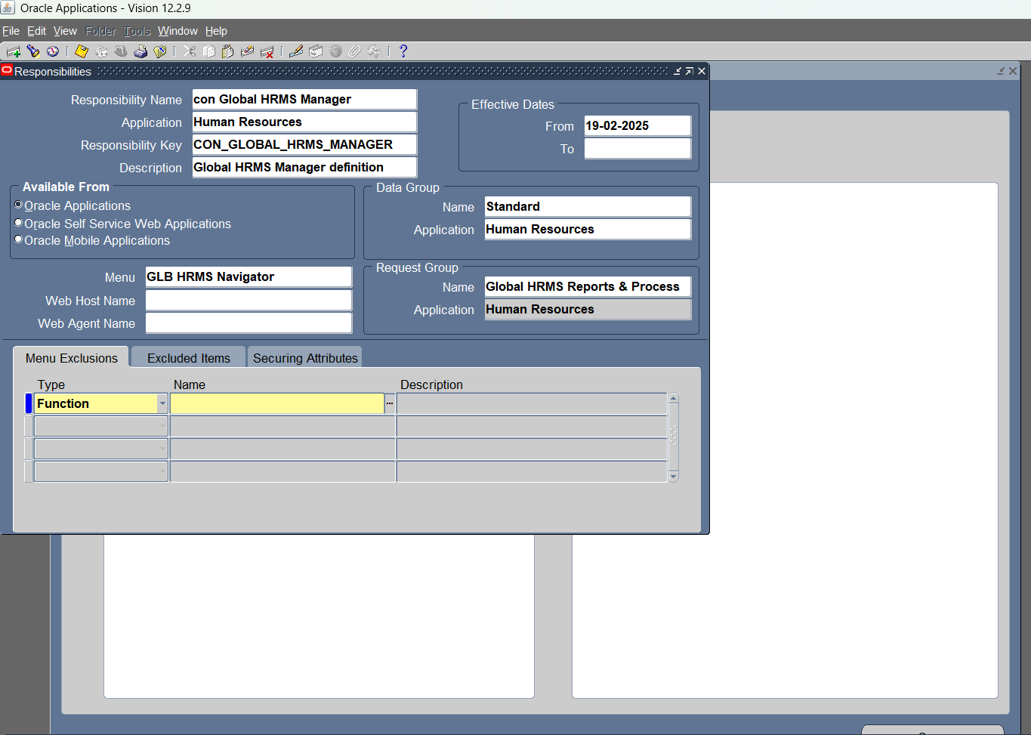
1- Create new responsibilities (Global HRMS Manager) to use it in creation of Operating units, inventory organizations, locations, currencies, employees, jobs, positions

Slide 16
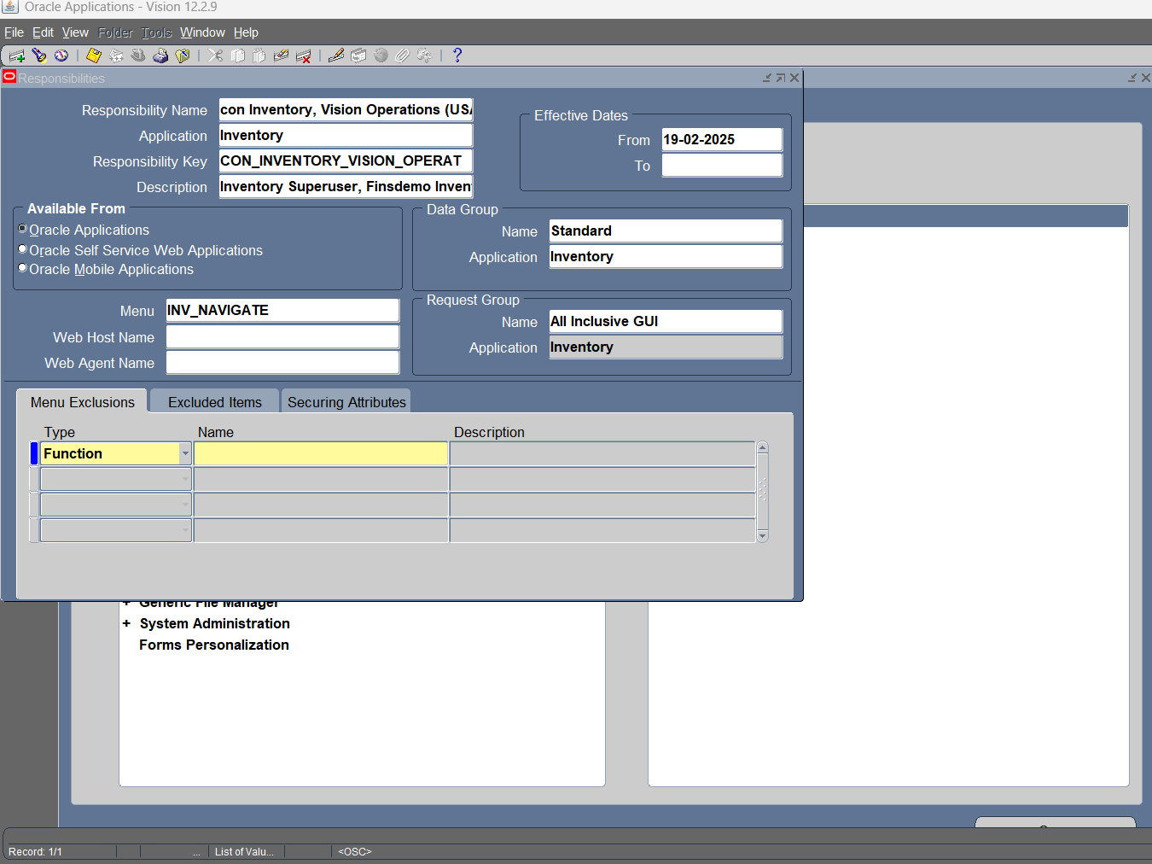
1.1- Create new responsibilities (inventory responsibility)

Slide 17
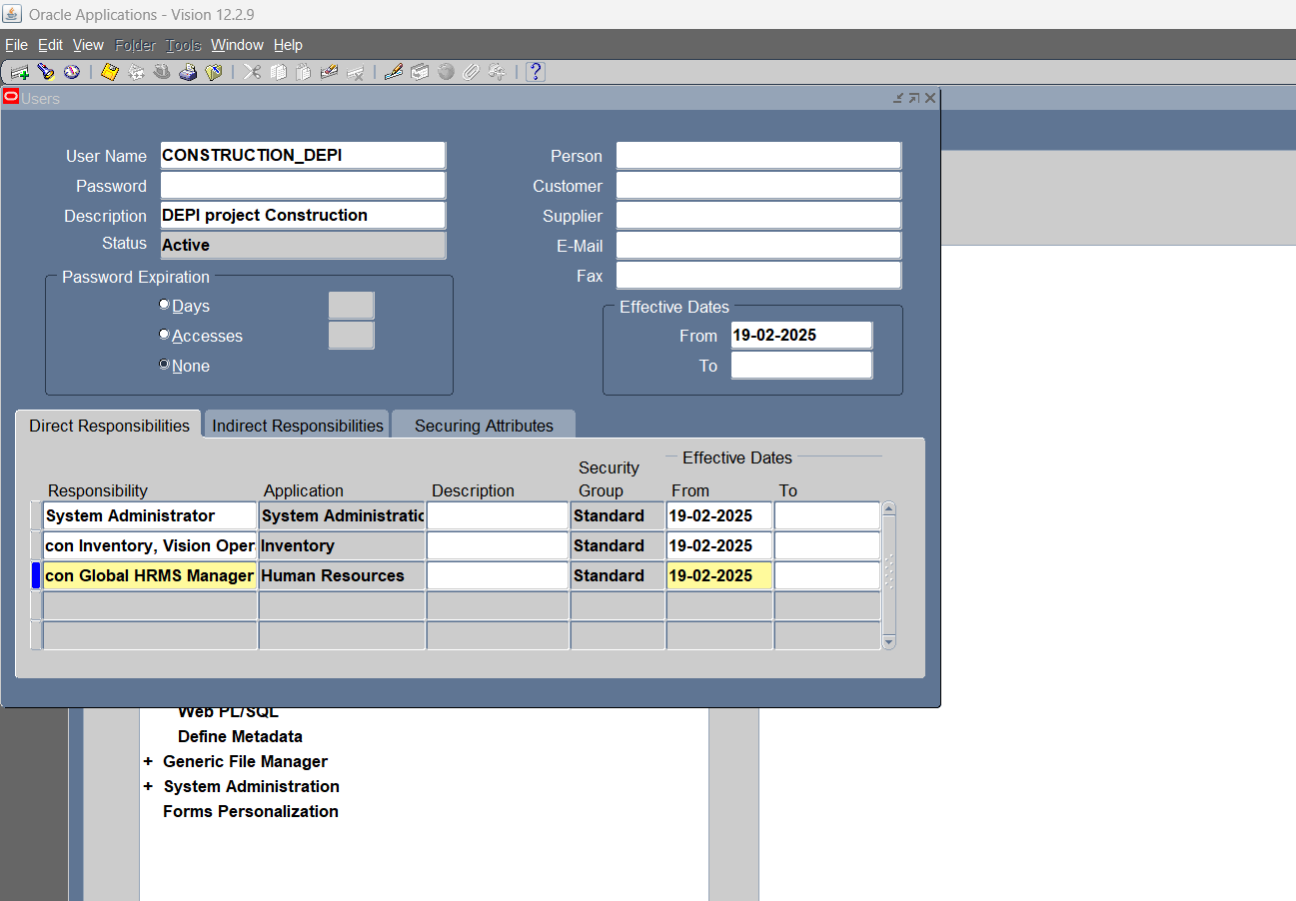
2- Create new users

Slide 18
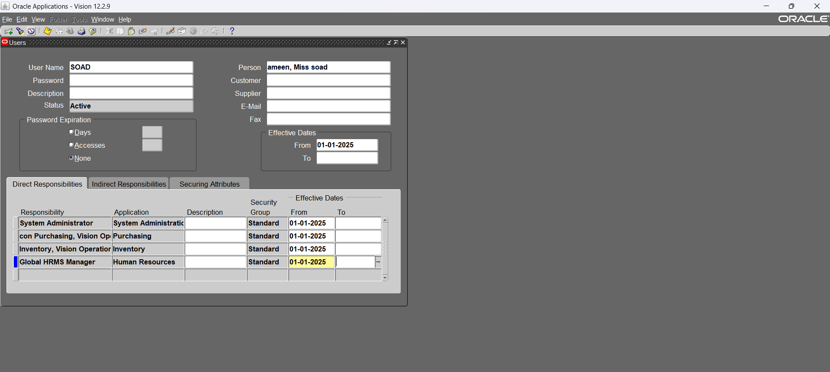
2.1- new user

Slide 19
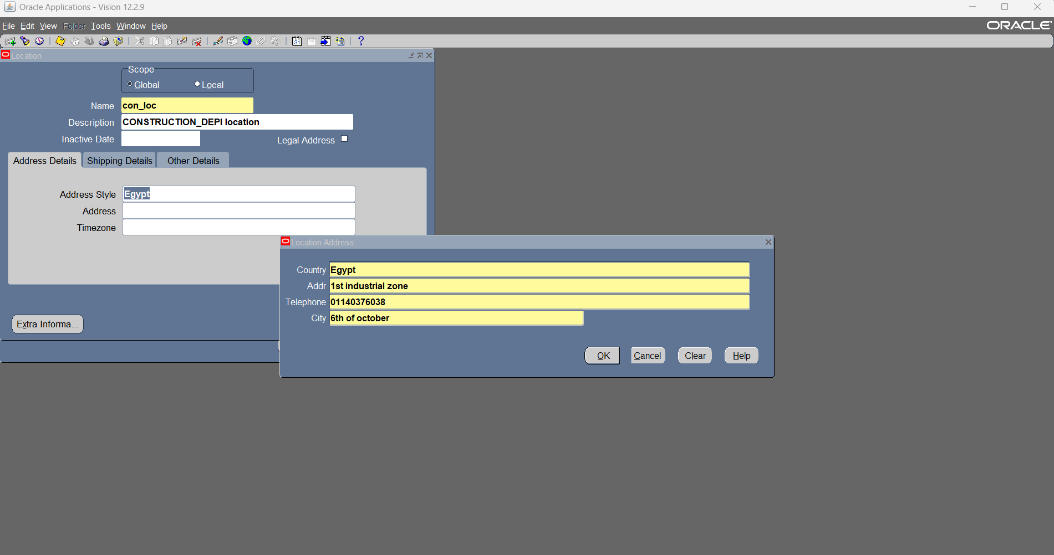
3- Create new Location

Slide 20
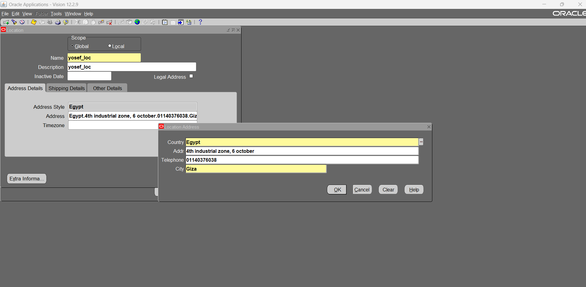
3.1- new location

Slide 21
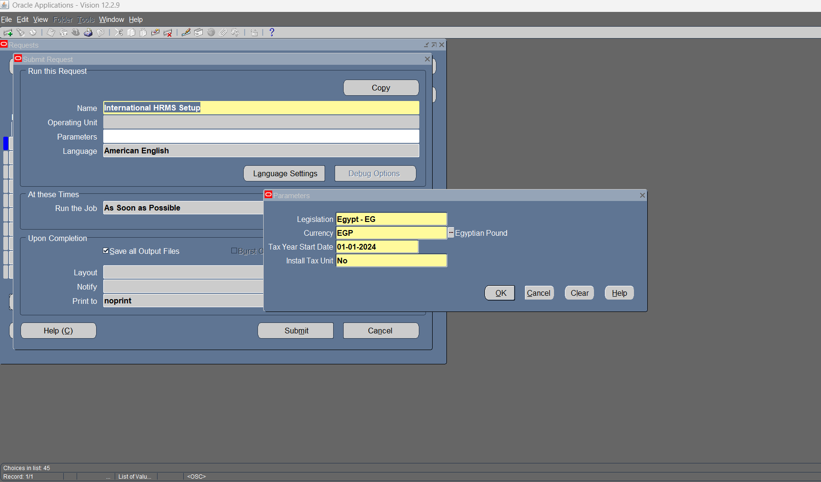
3.2- Run International HRMS Setup request

Slide 22
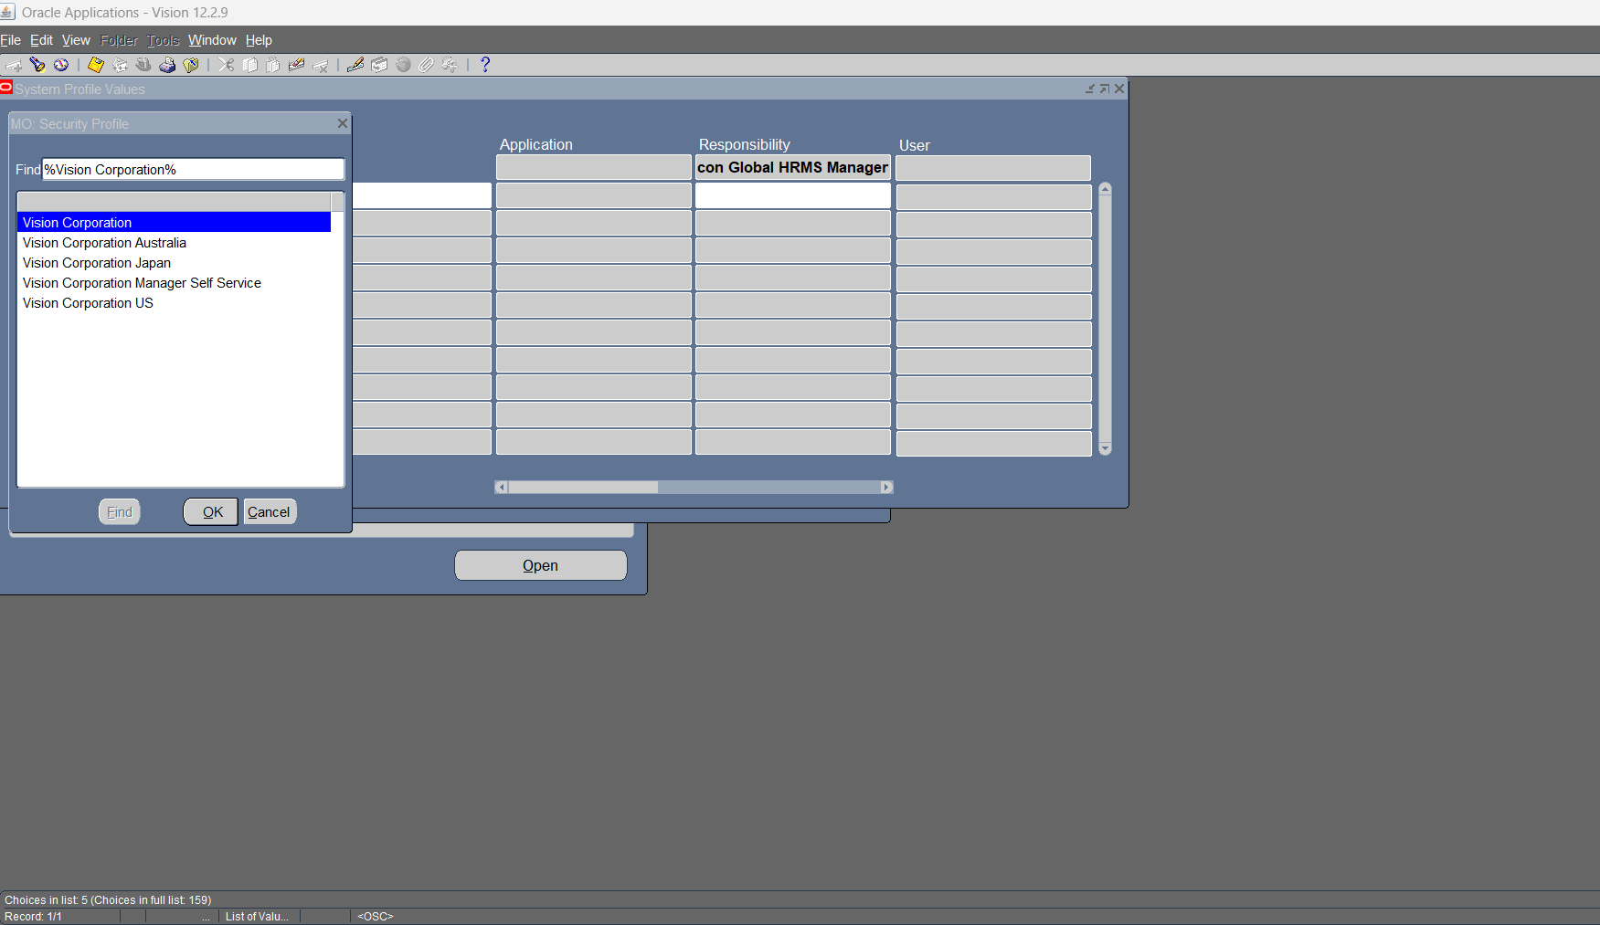
3.3- Change profile options for new responsibilities

Slide 23
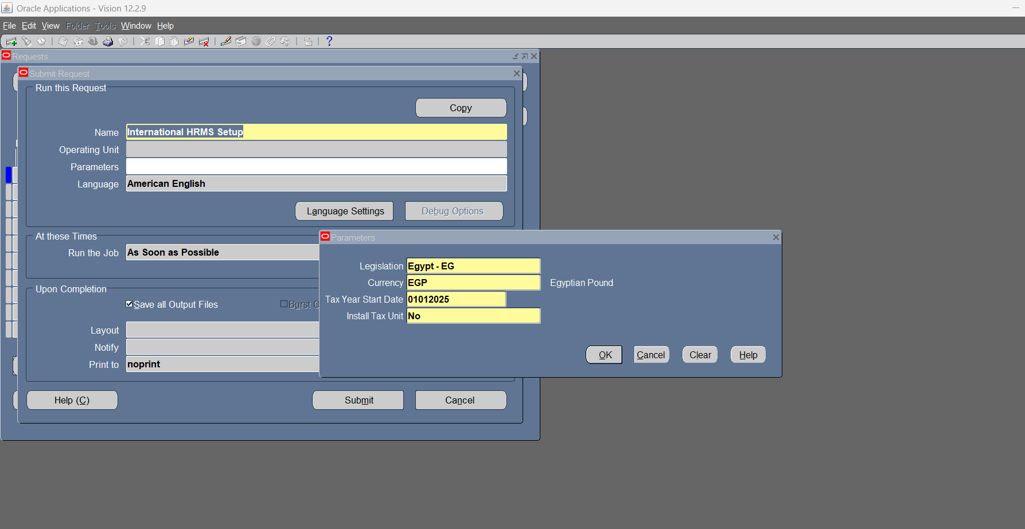

Slide 24
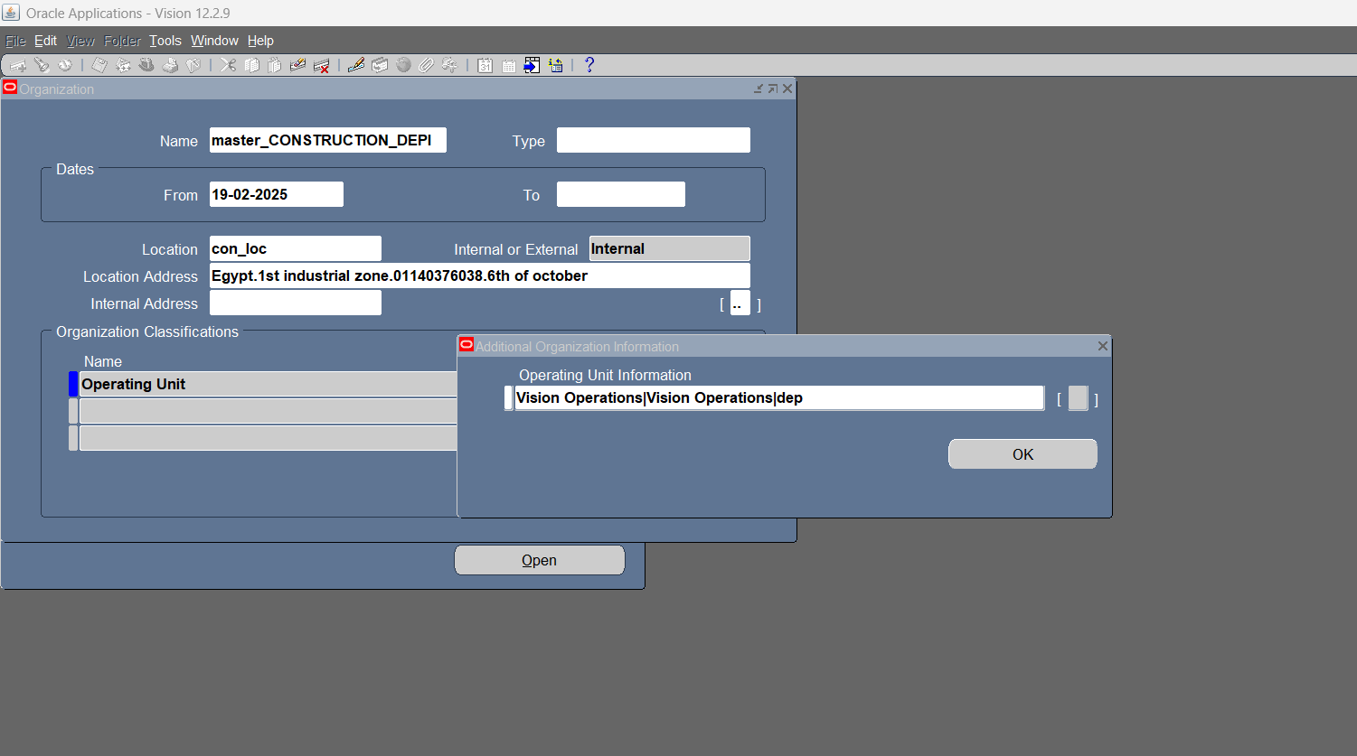
4- Create new Operating Unit

Slide 25
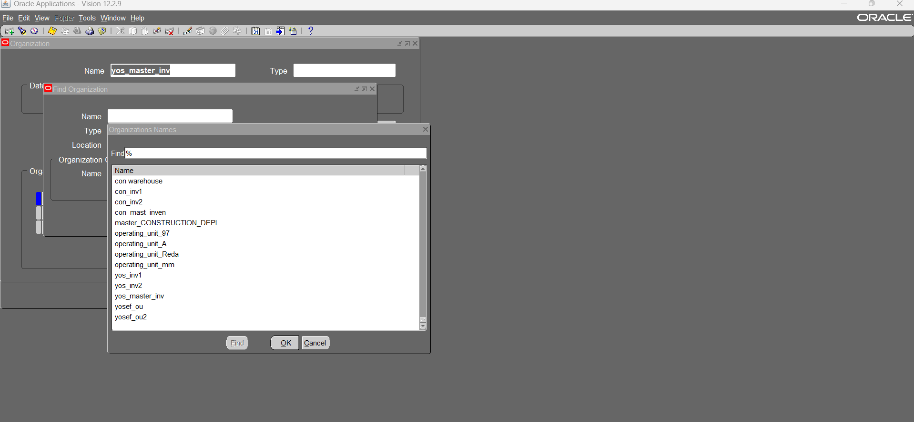
4.1- operating units & master inventory organization & inventory organization, etc…..

Slide 26
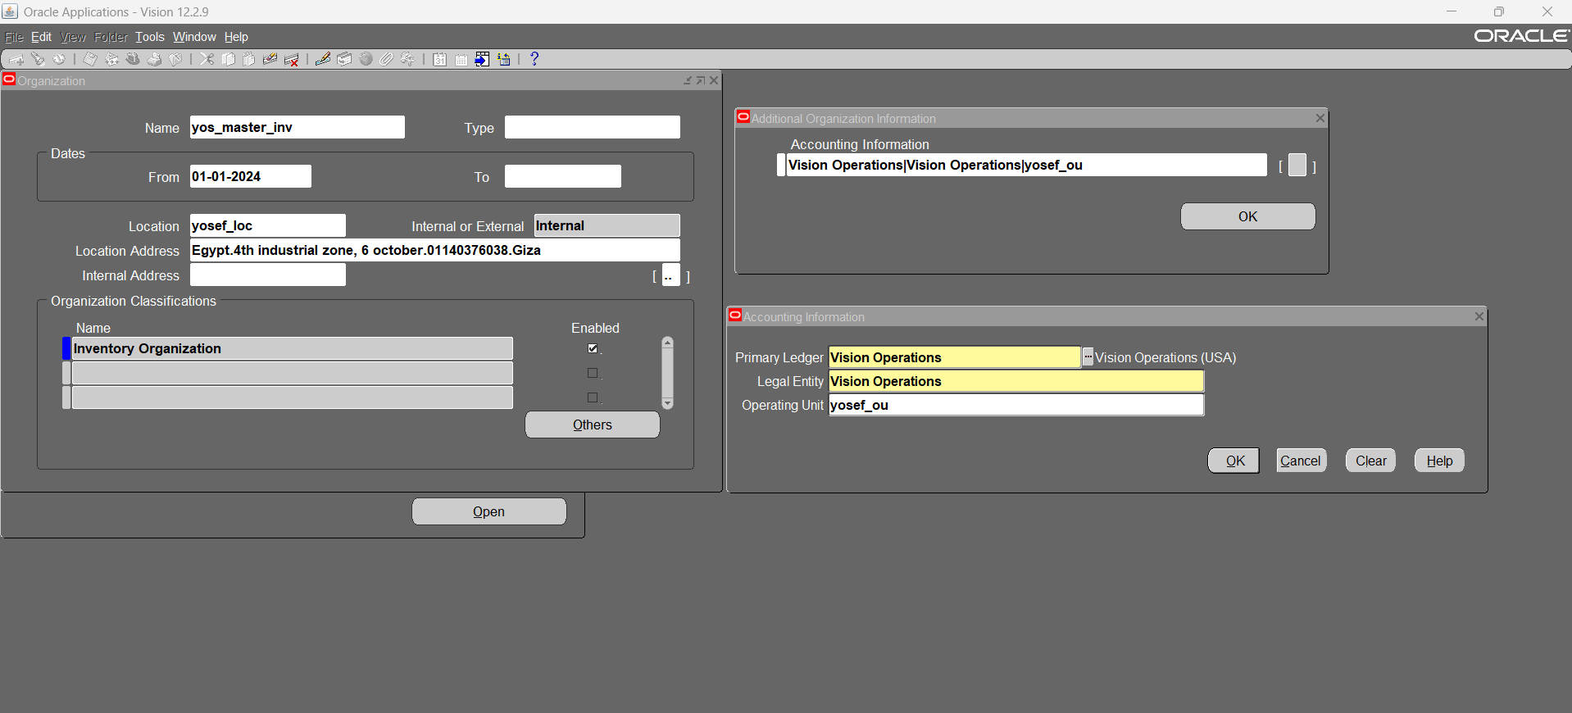
5- Create new Master Inventory organization

Slide 27
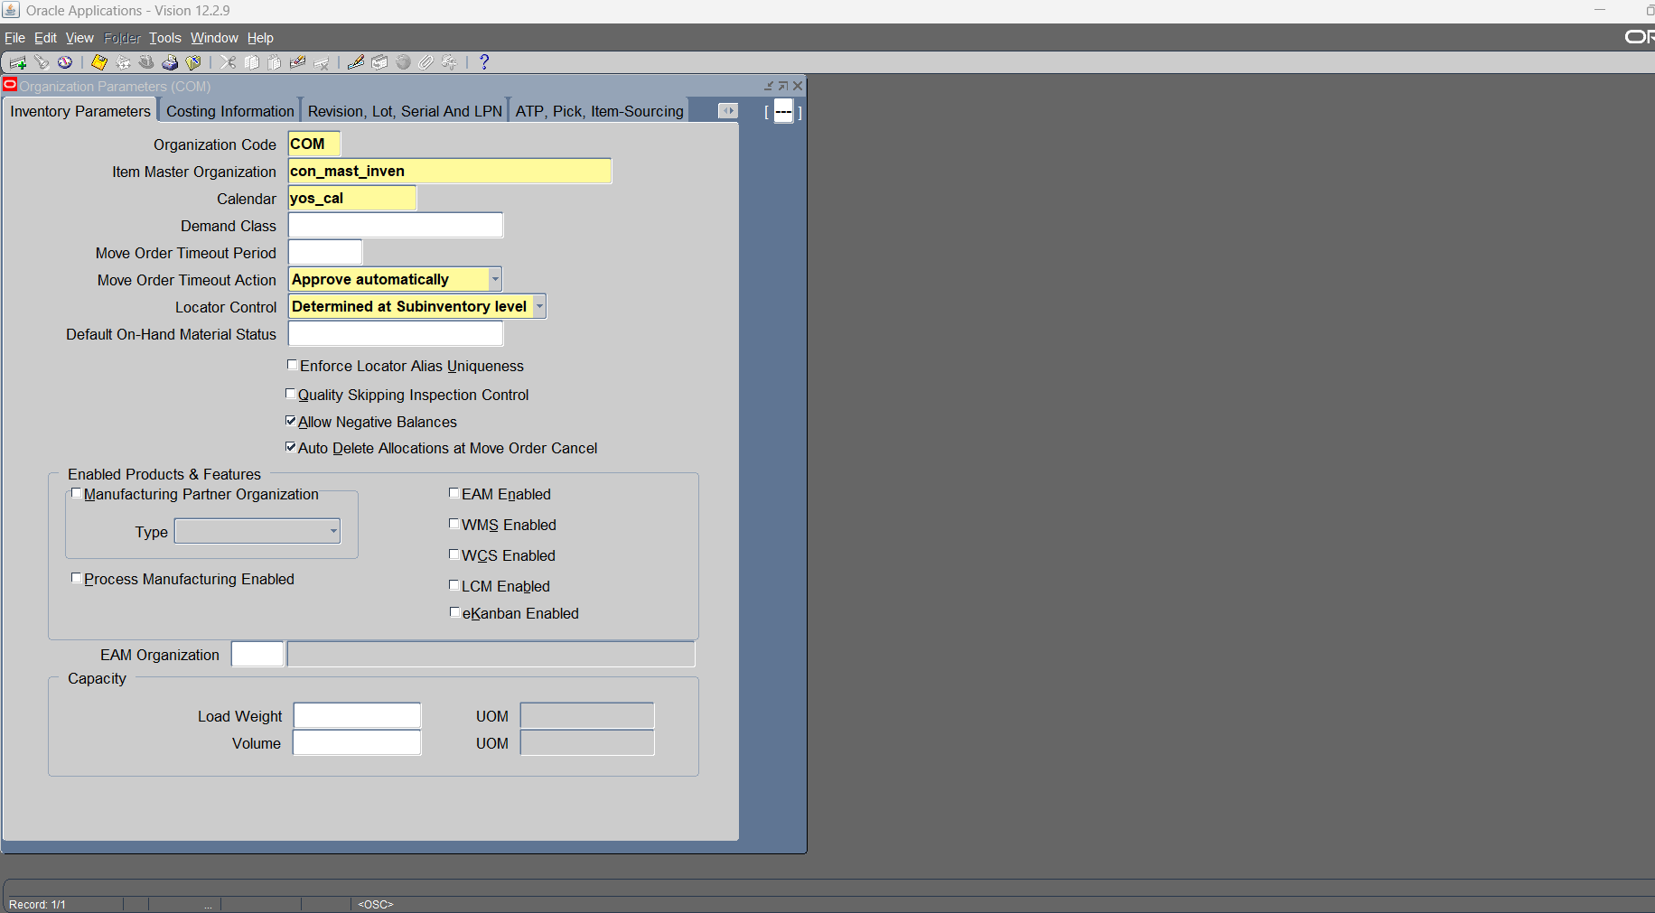
5.1- define organization parameters for new Master Inventory organization

Slide 28
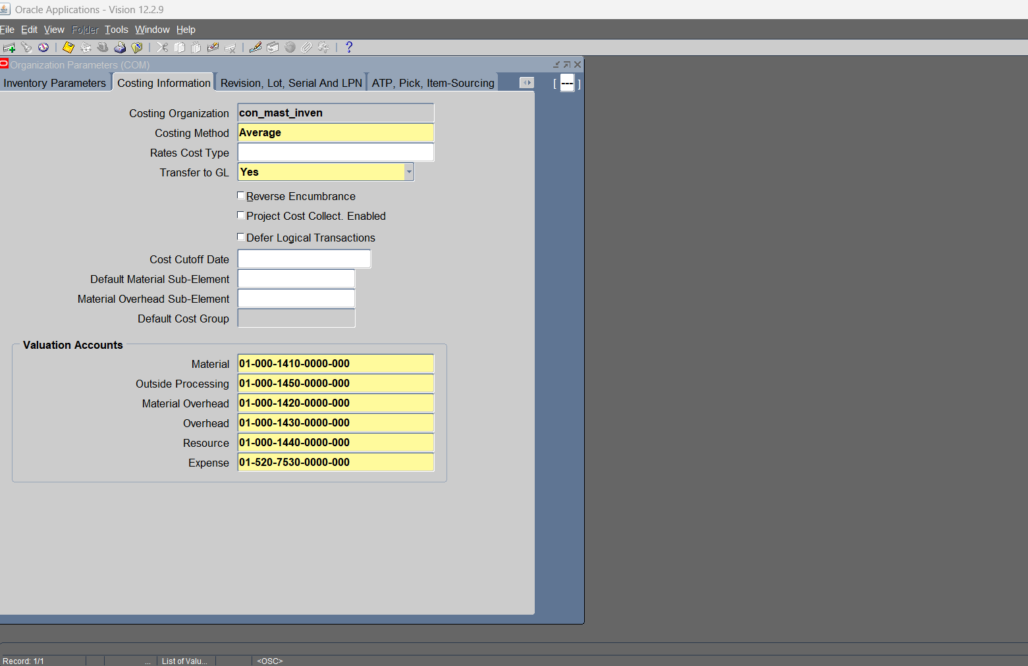
5.2- define organization parameters (Costing information)

Slide 29
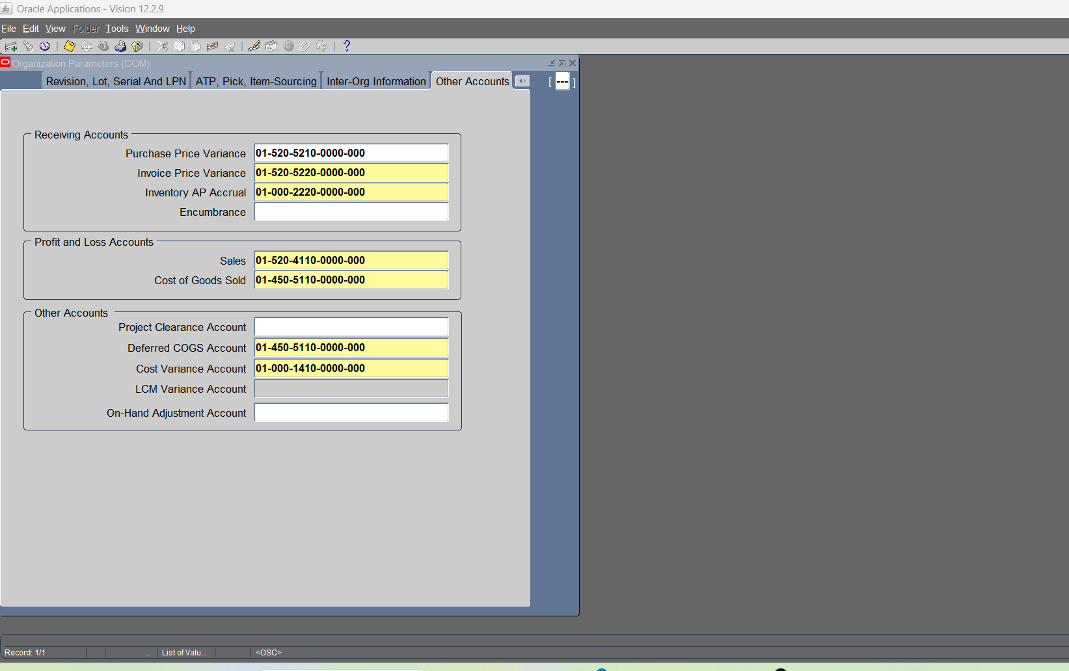
5.3- define organization parameters (accounting information)

Slide 30
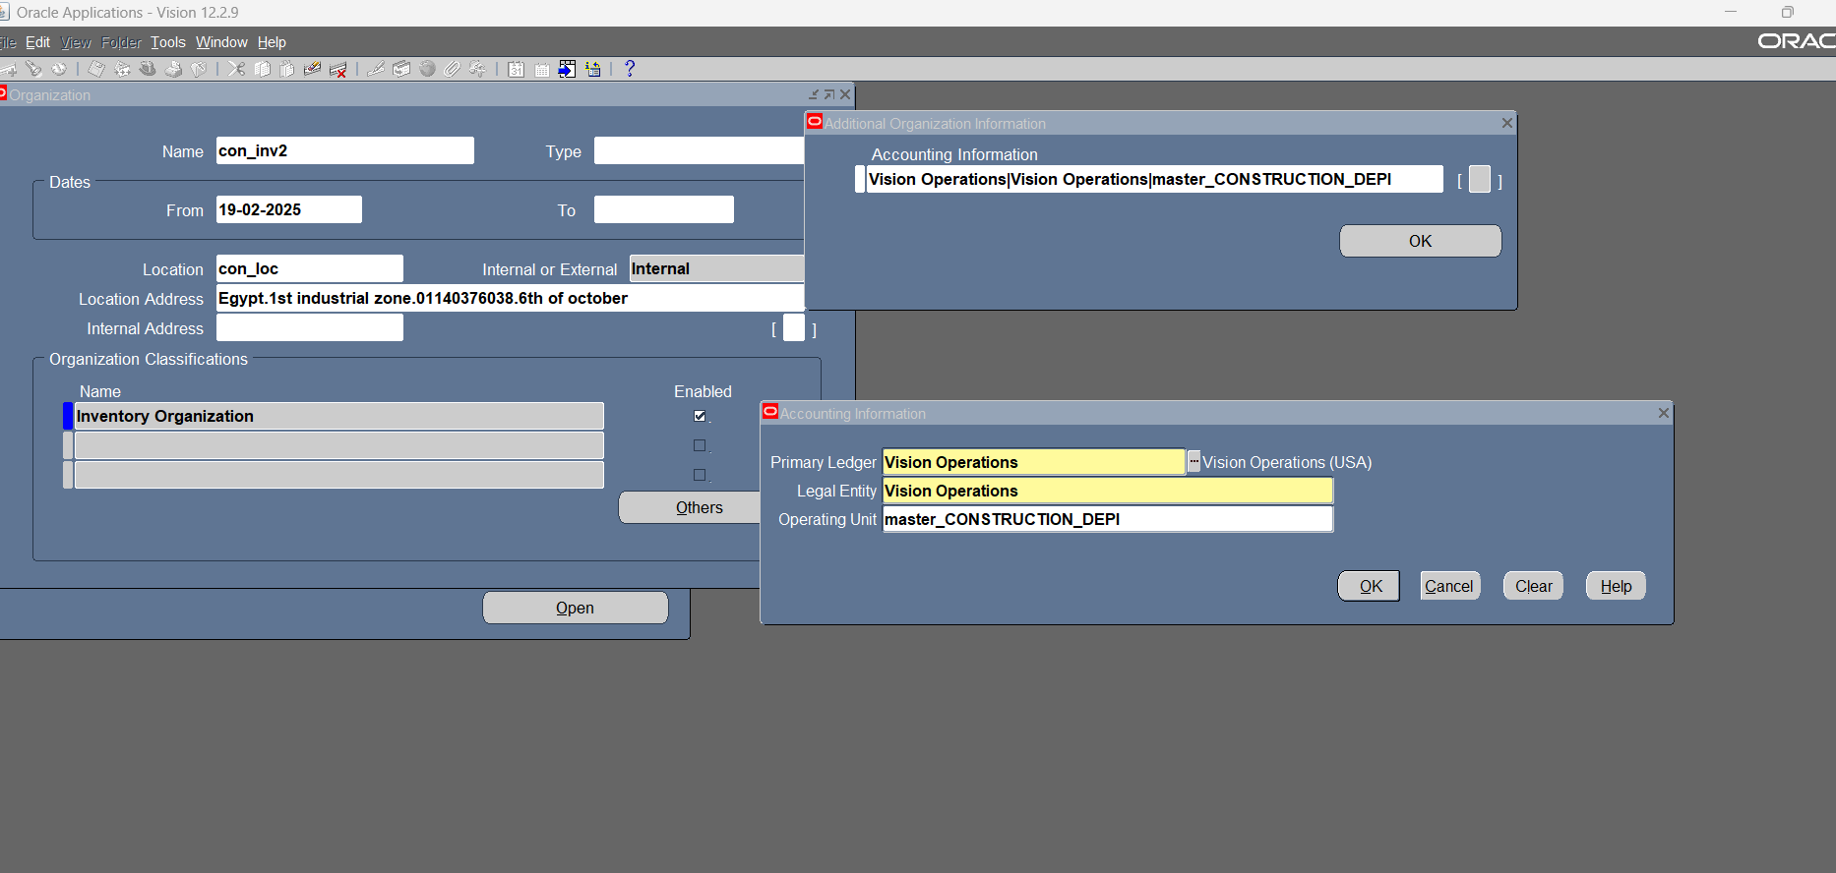
6- Create Inventory Organization

Slide 31
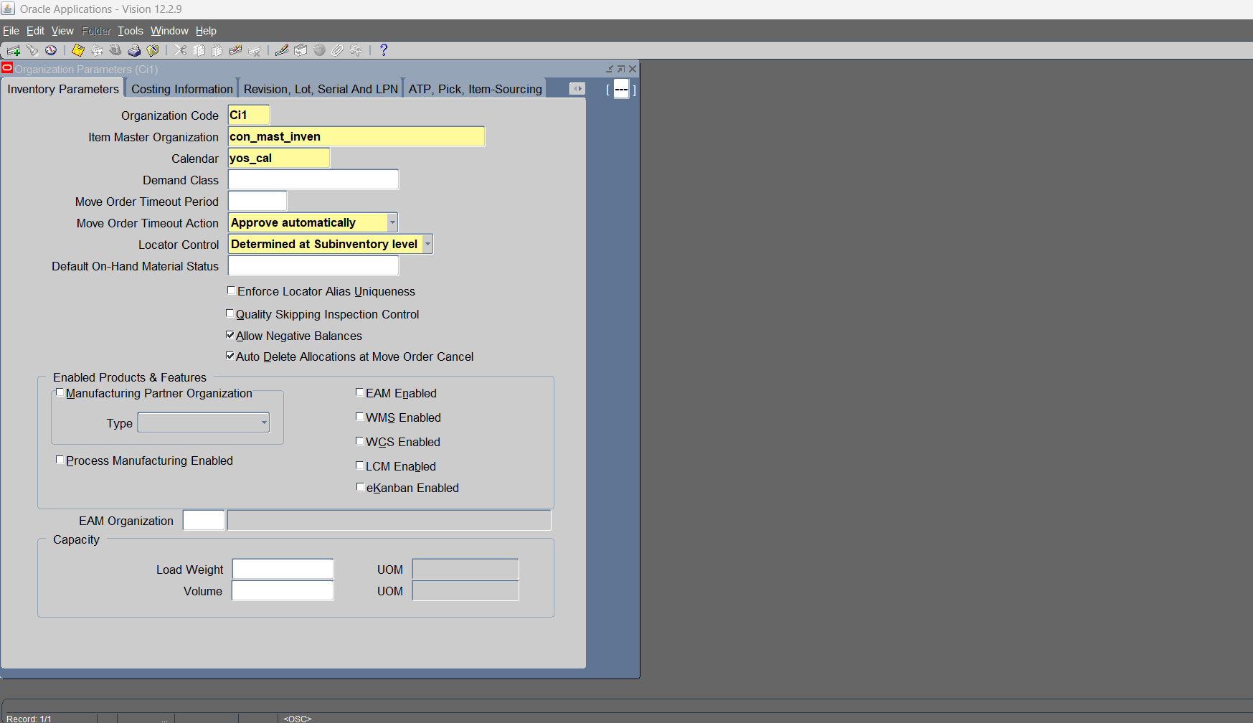
6.1- define organization parameters for new Inventory organization

Slide 32
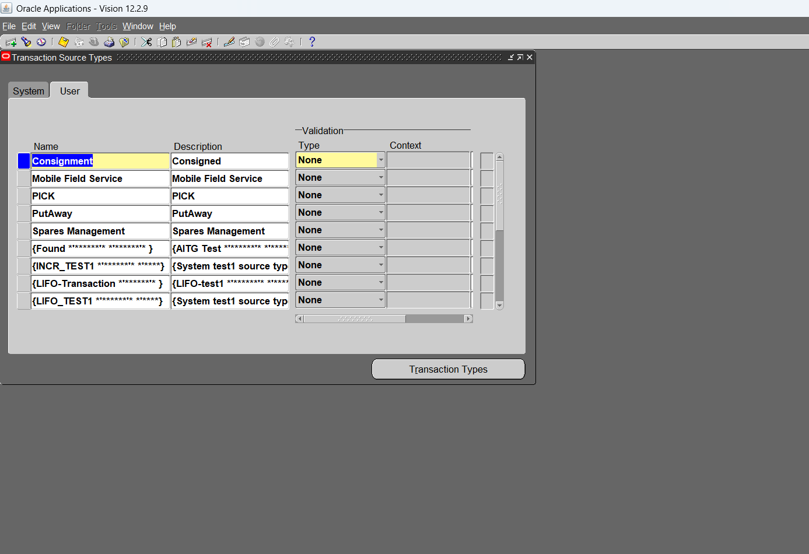
7- Transaction source type

Slide 33
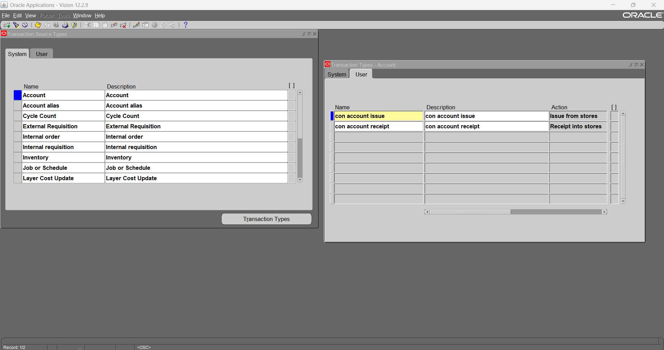
7.1- define new Transaction source type (Account)

Slide 34
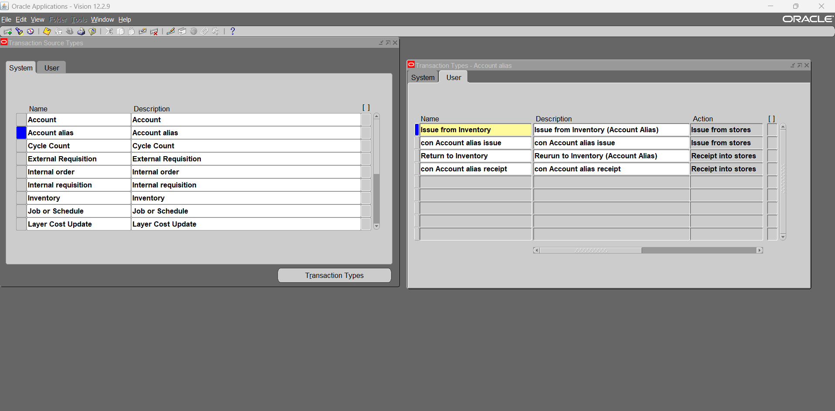
7.2- define new Transaction source type (Account alias)

Slide 35
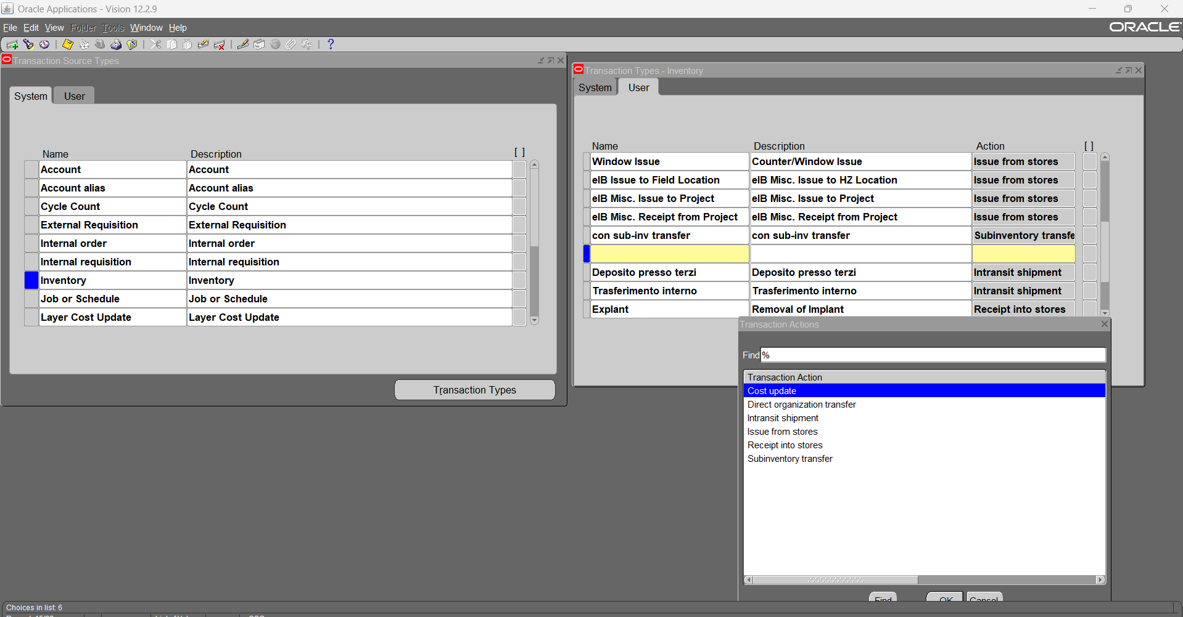
7.3- define new Transaction source type (sub-inventory transfer)

Slide 36
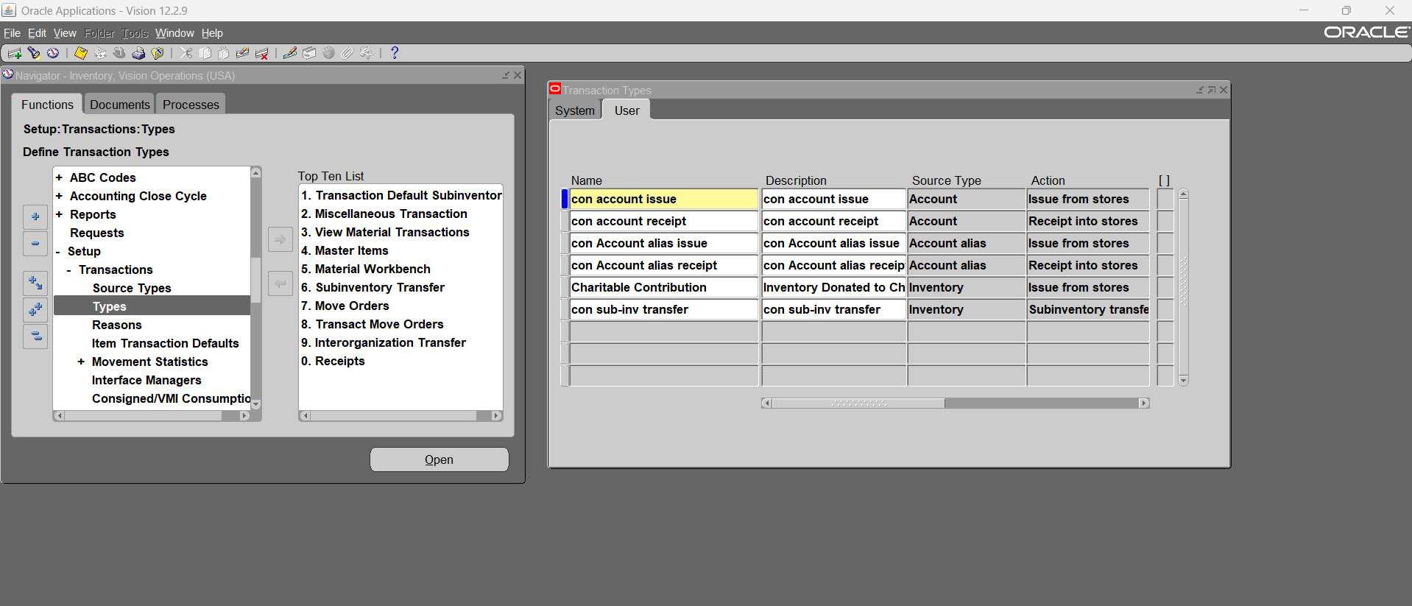
7.4- summary for new Transaction source type

Slide 37
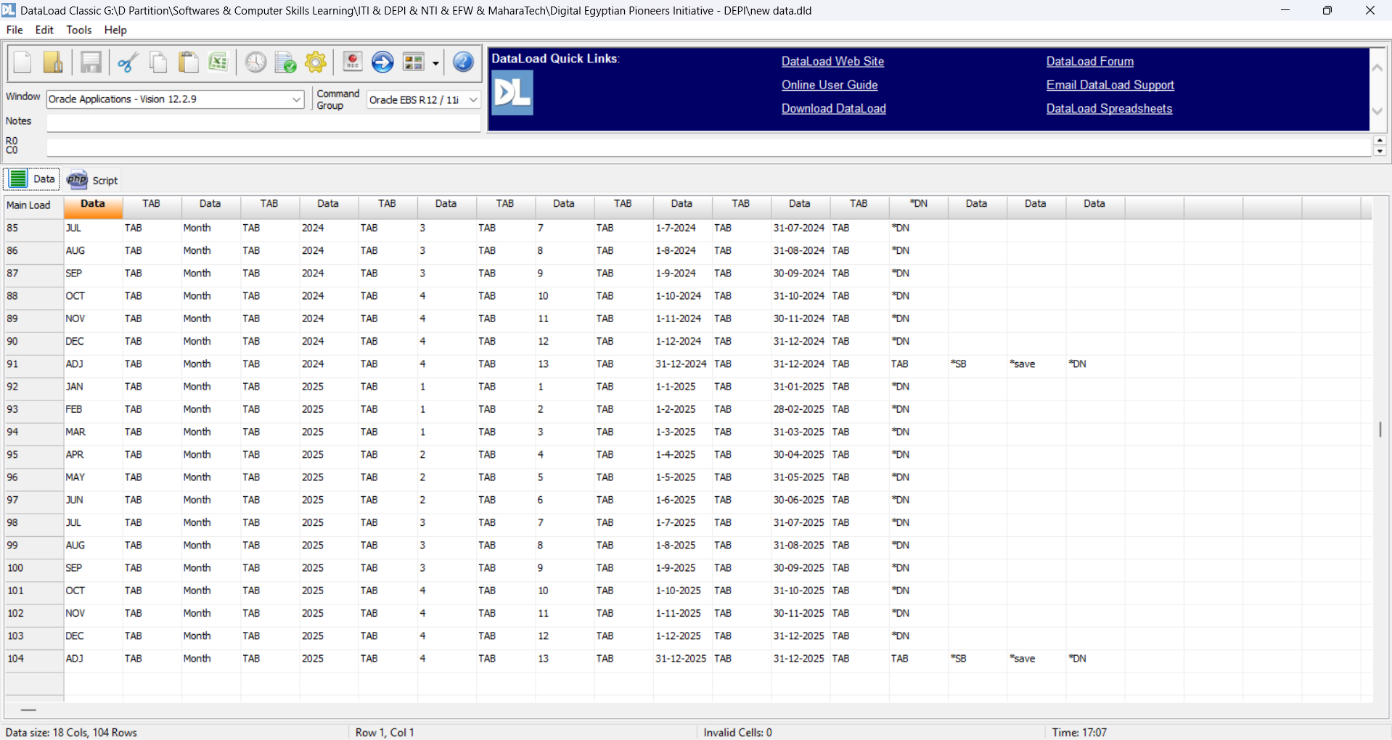
8- Using DataLoad to add new accounting periods

Slide 38
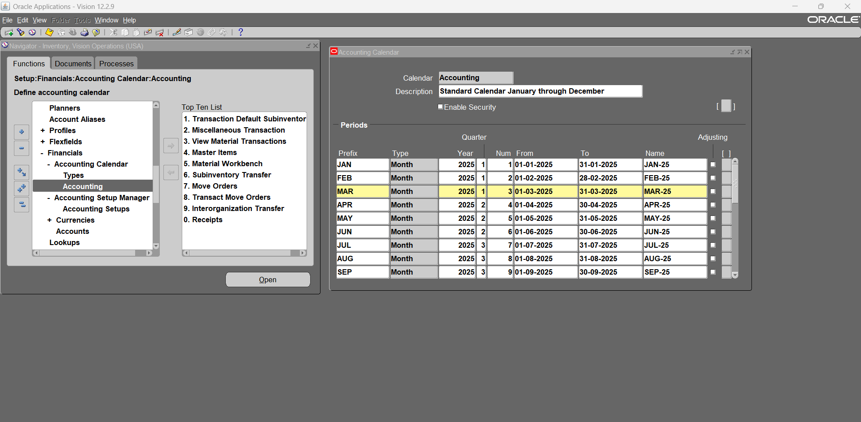
8.1- new accounting periods

Slide 39
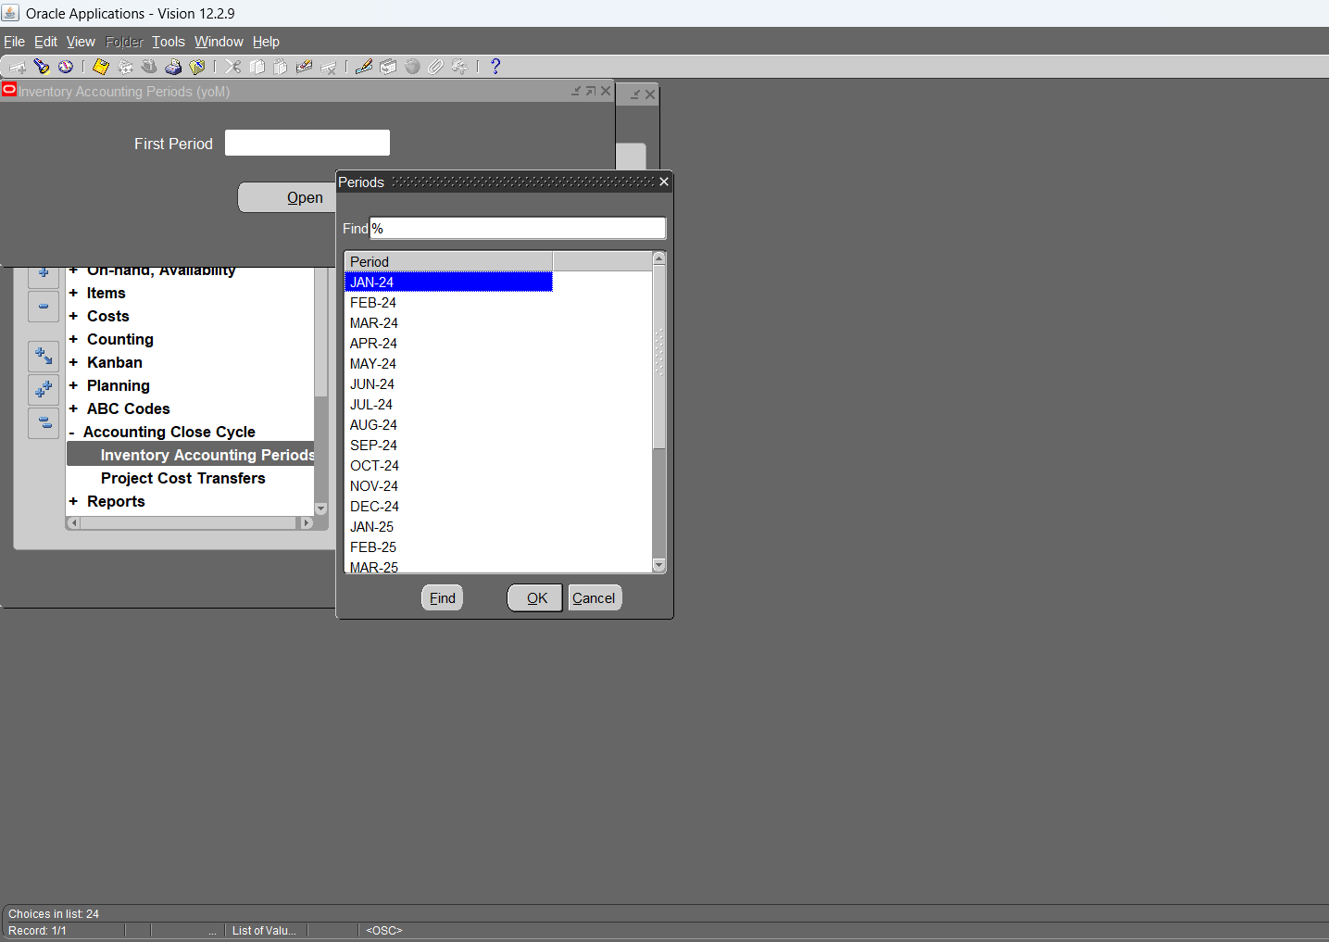
8.2- Open inventory accounting periods

Slide 40
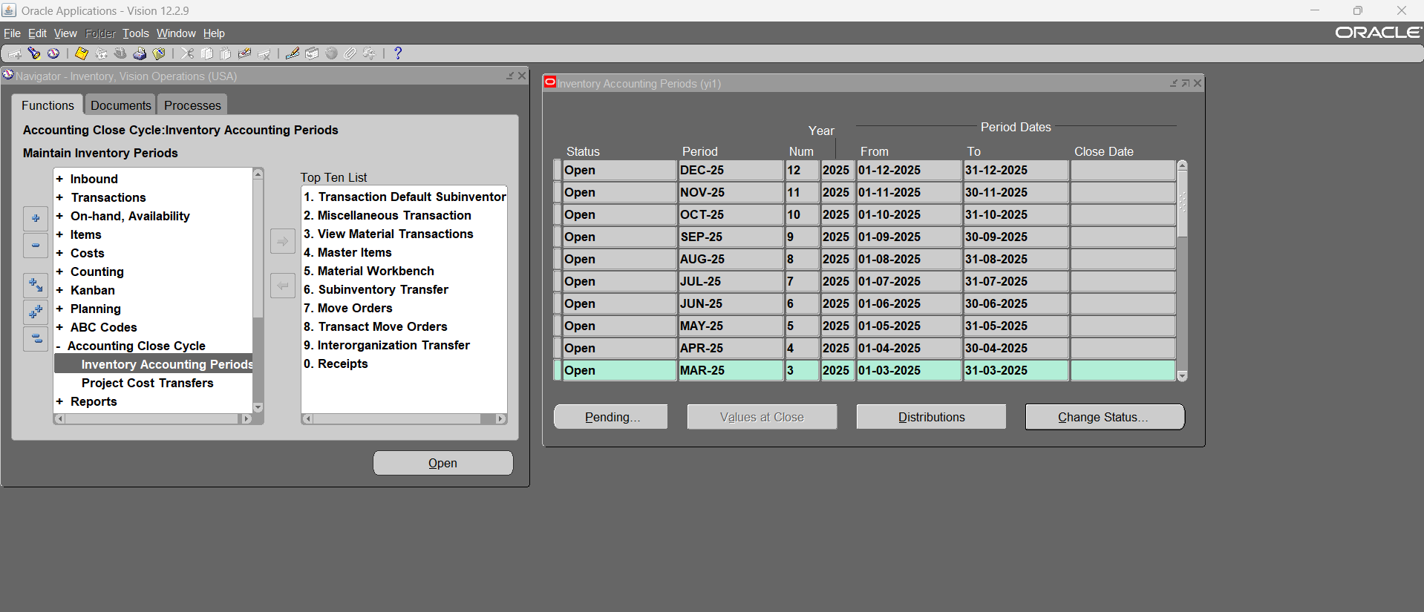
8.3- inventory accounting periods

Slide 41
Transactions

Slide 42
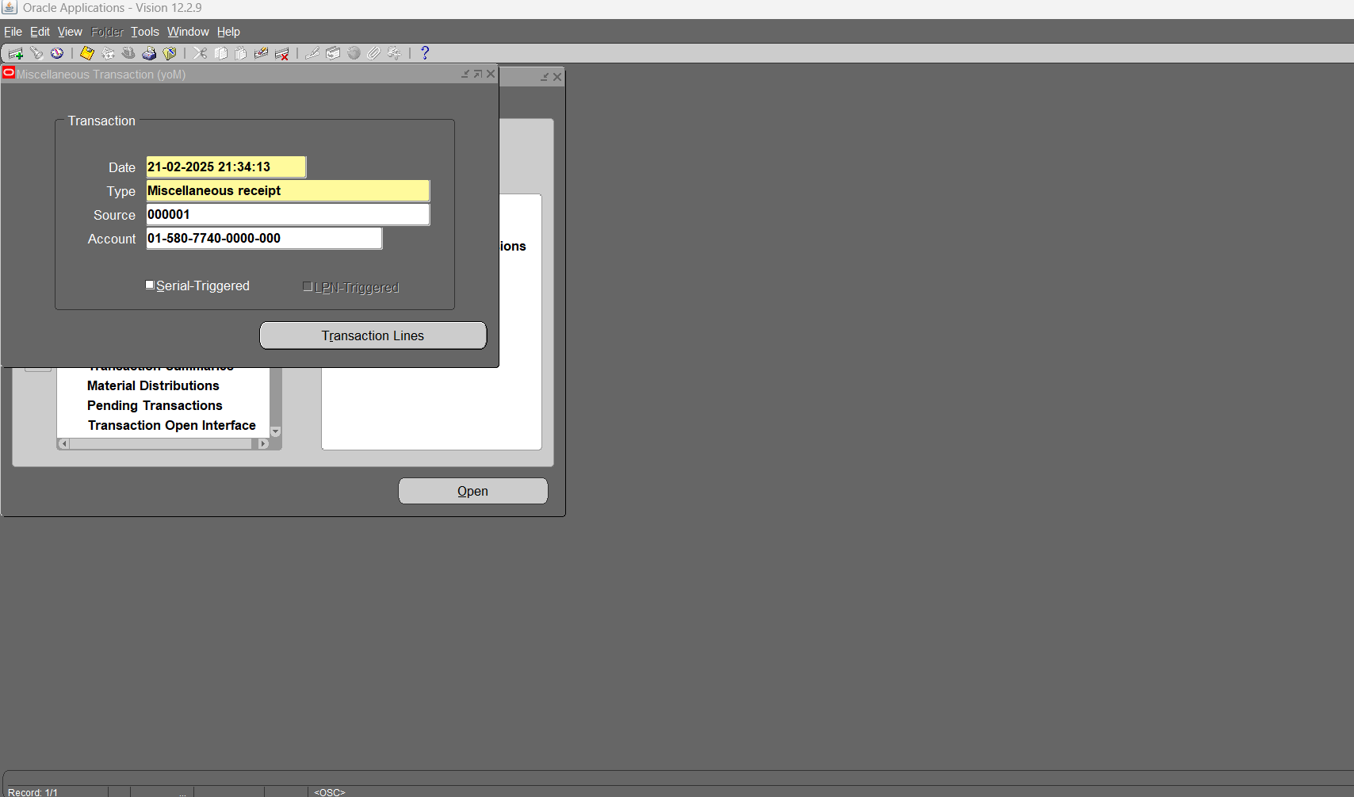
9- Create Miscellaneous Transactions (Miscellaneous Receipt) – we can change selected account at each line

Slide 43
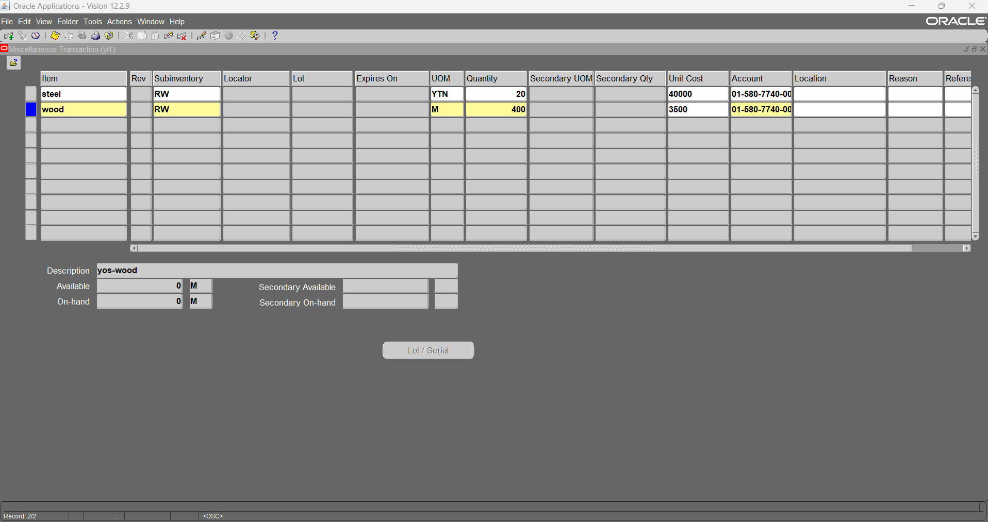
9.1- Miscellaneous Transactions NO.1

Slide 44
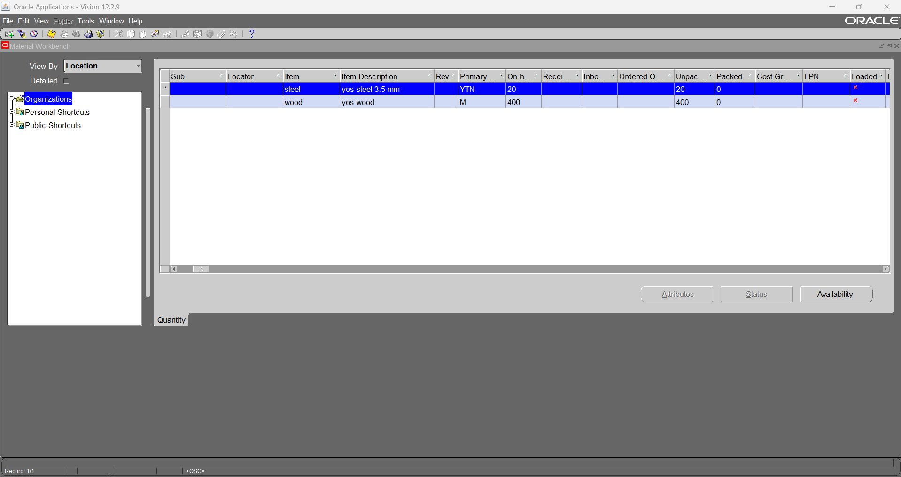
9.2- On-hand for Miscellaneous Transactions NO.1

Slide 45
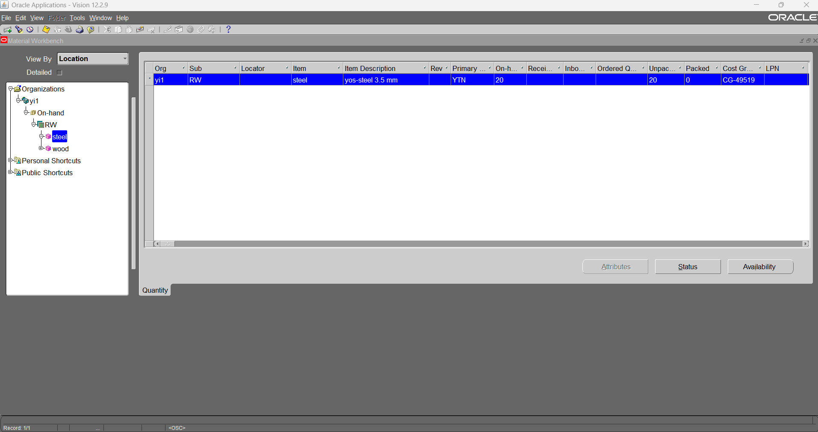
9.2-

Slide 46
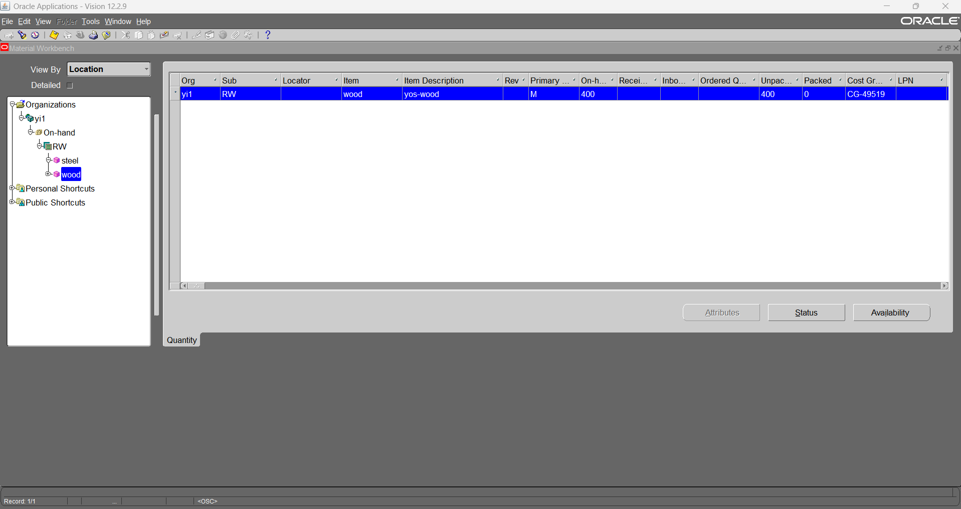
9.2-

Slide 47
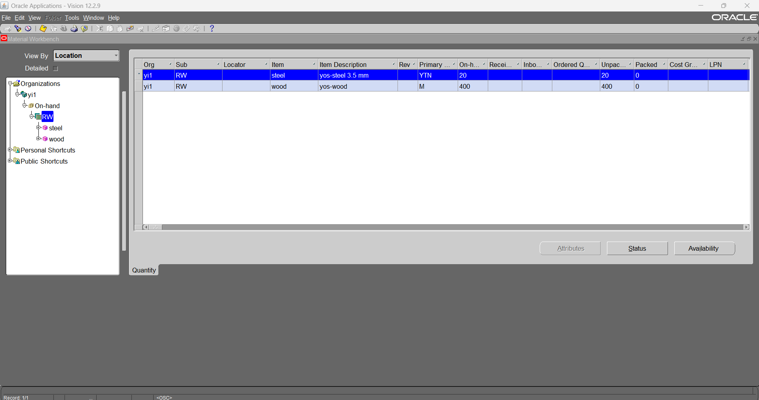
9.2-

Slide 48
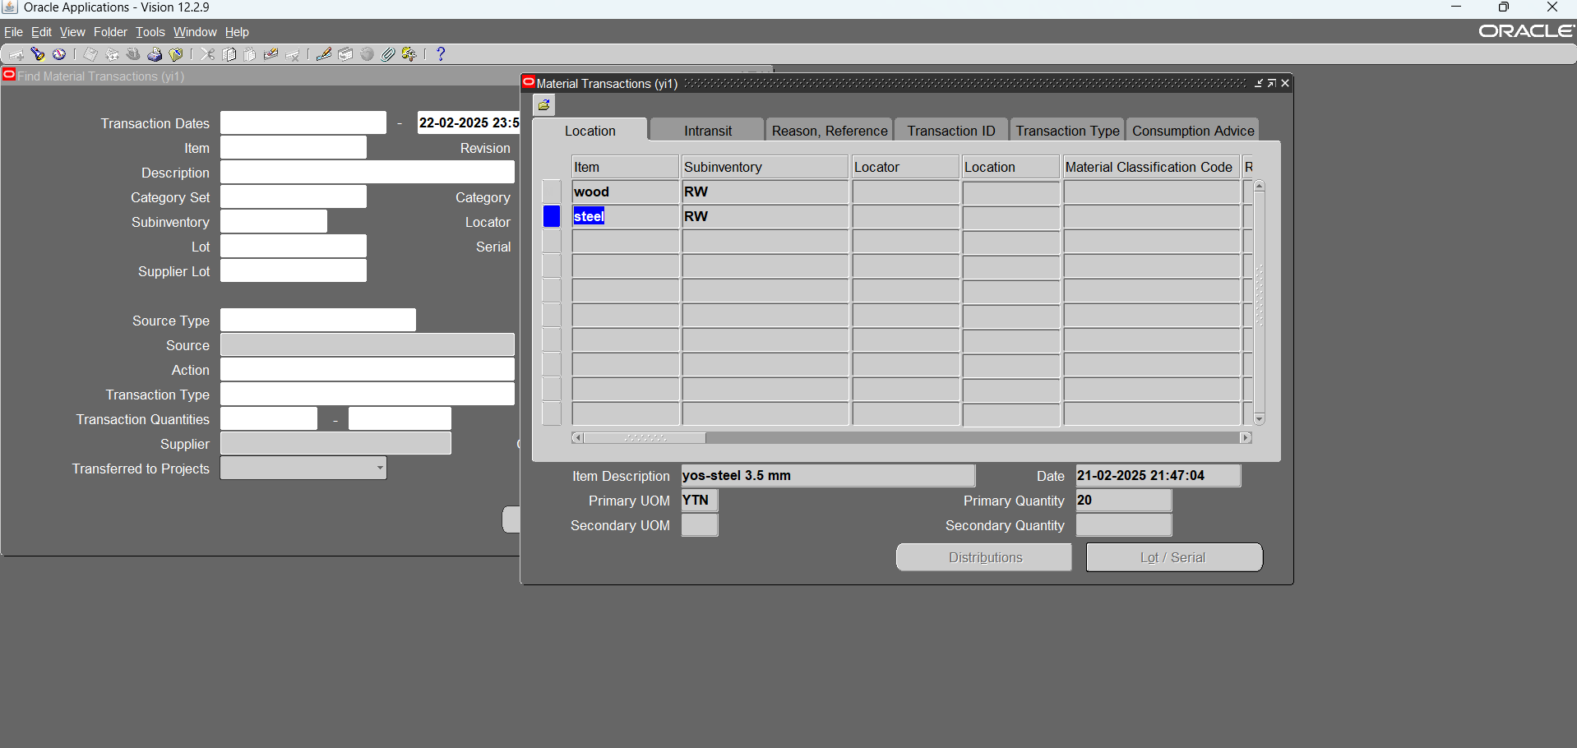
9.2- Miscellaneous Transactions NO.1

Slide 49
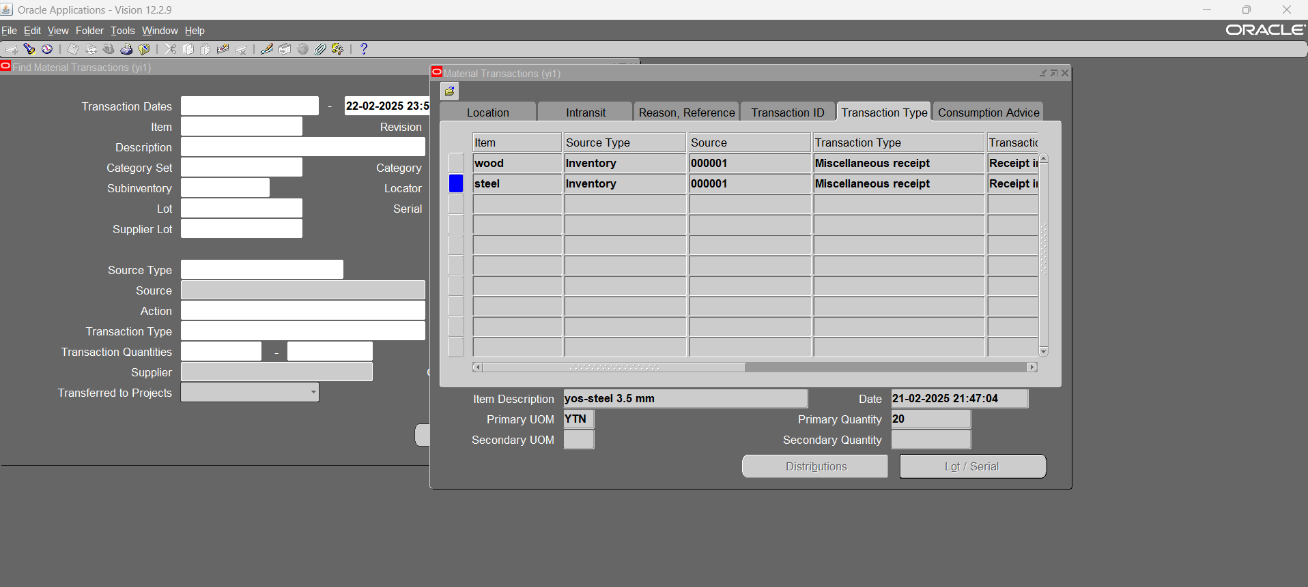
9.2- Miscellaneous Transactions NO.1

Slide 50
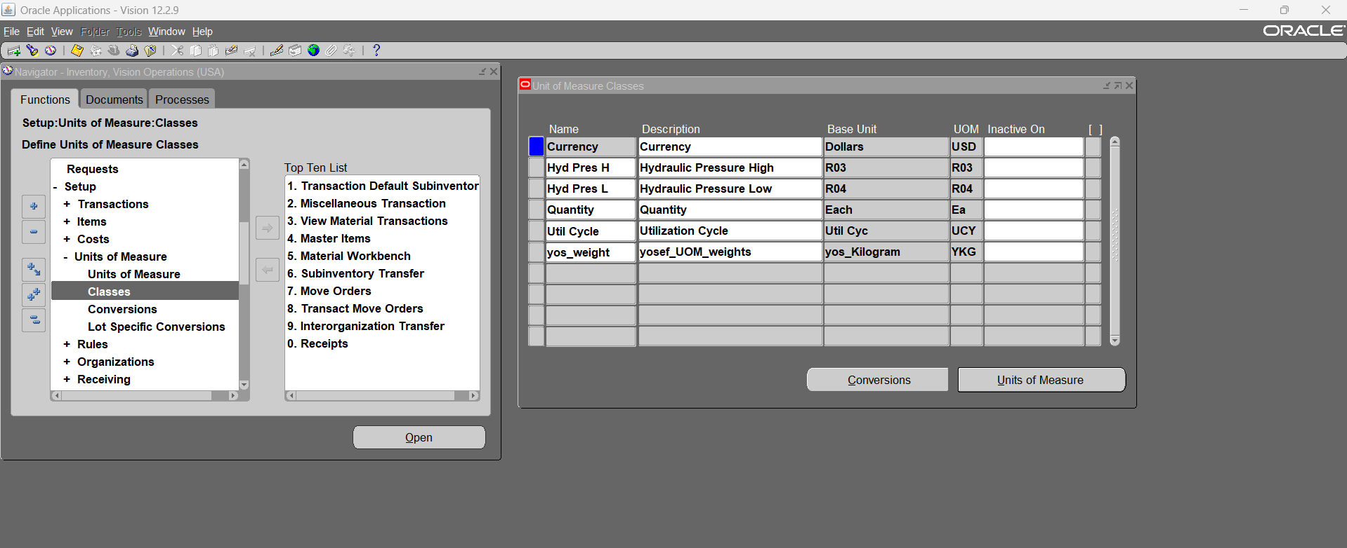
10- Define new UOM (Define new UOM class)

Slide 51
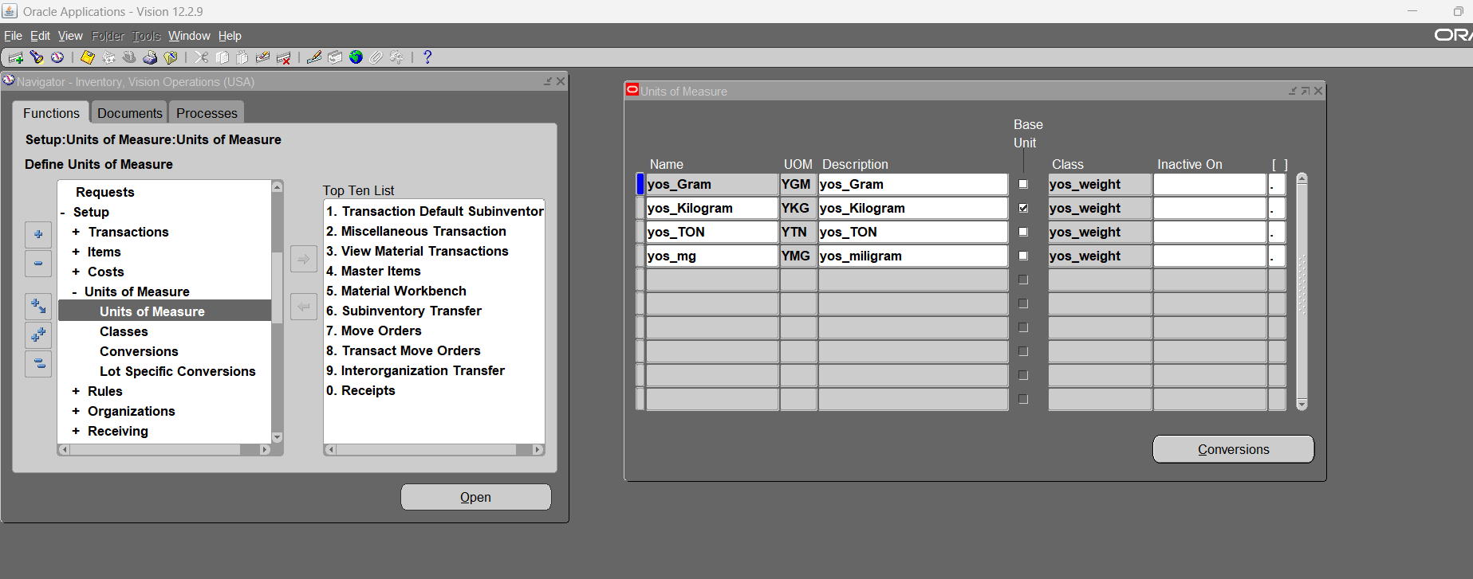
10.1- Define new UOM for the new class

Slide 52
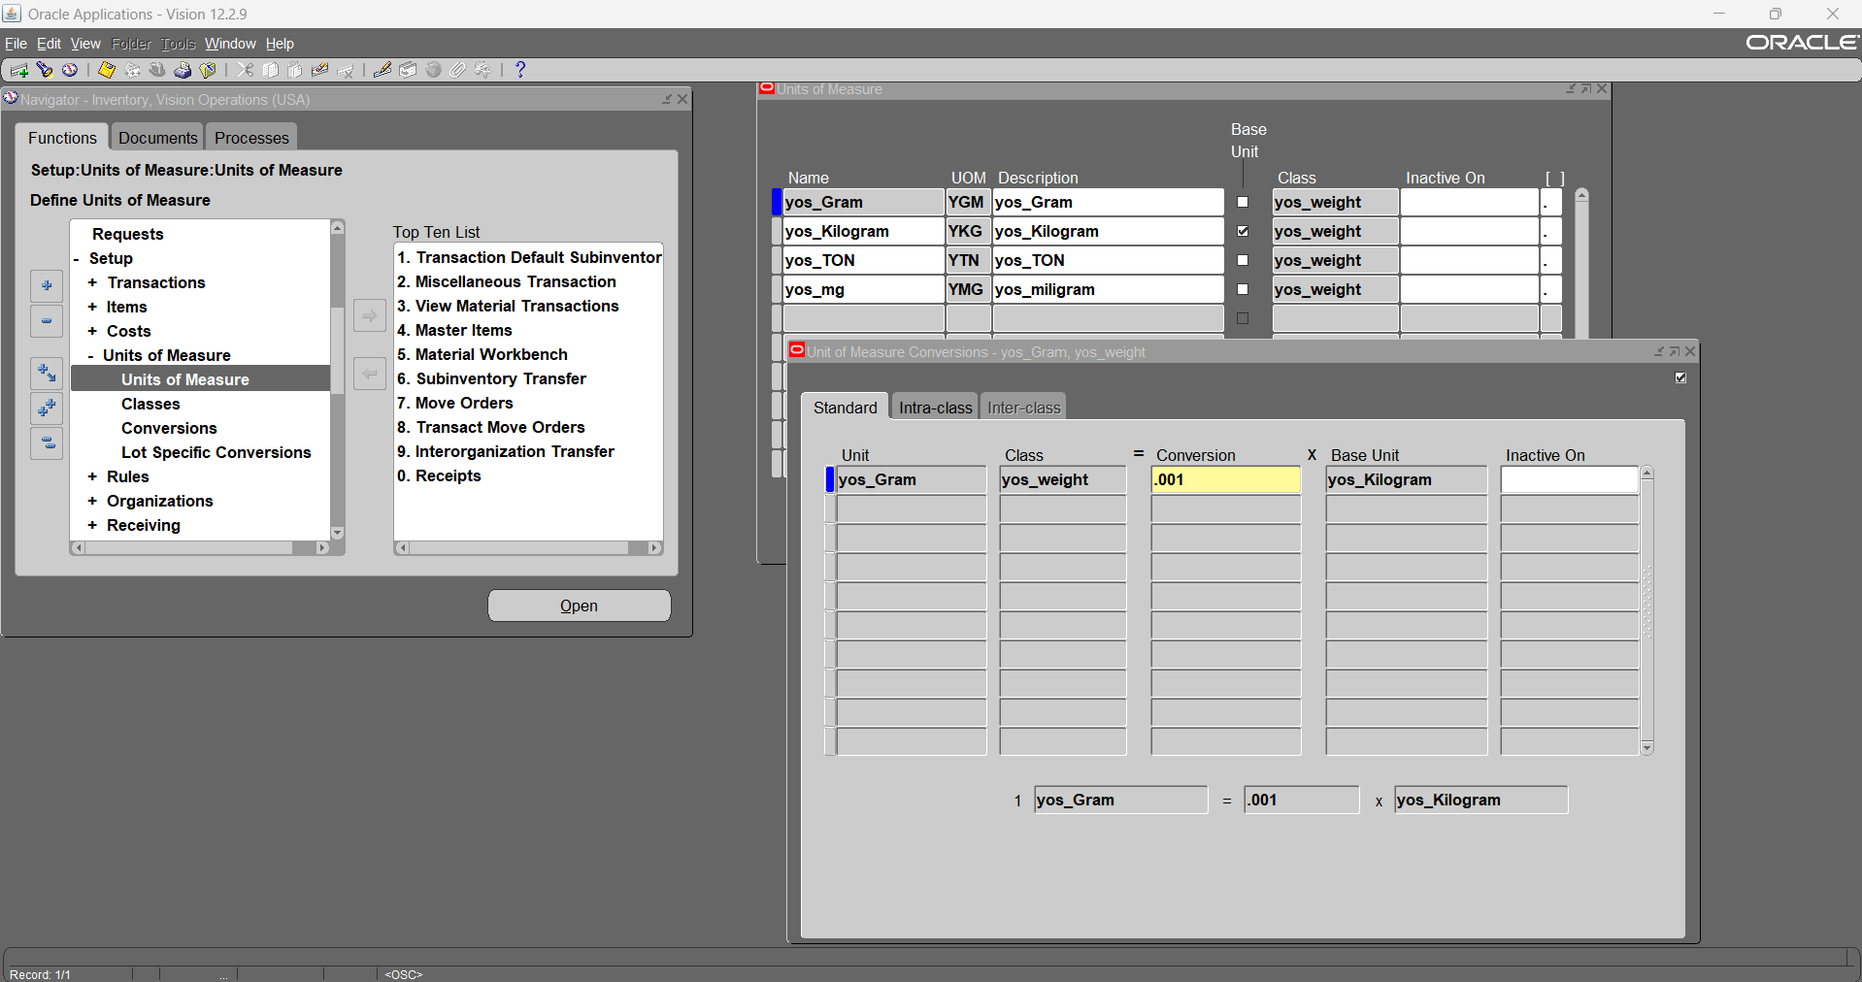
10.2- Define new UOM conversion

Slide 53
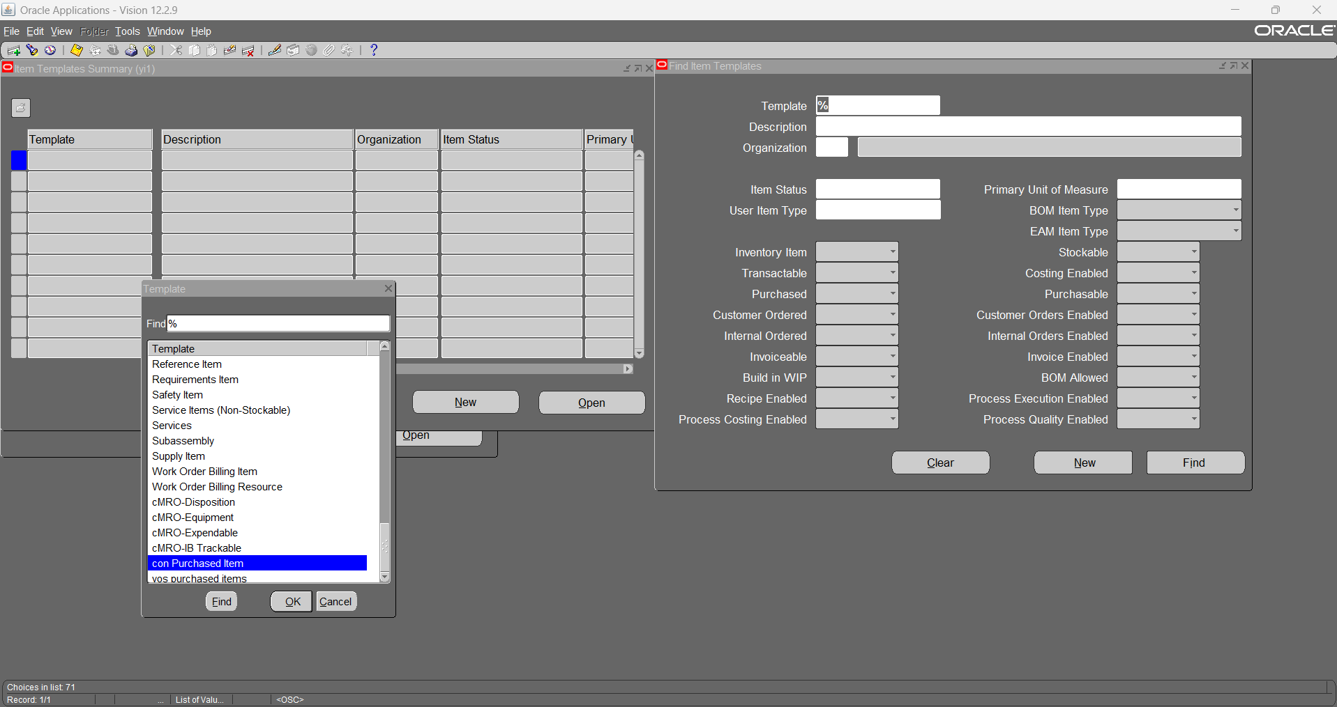
11- Define new item template

Slide 54
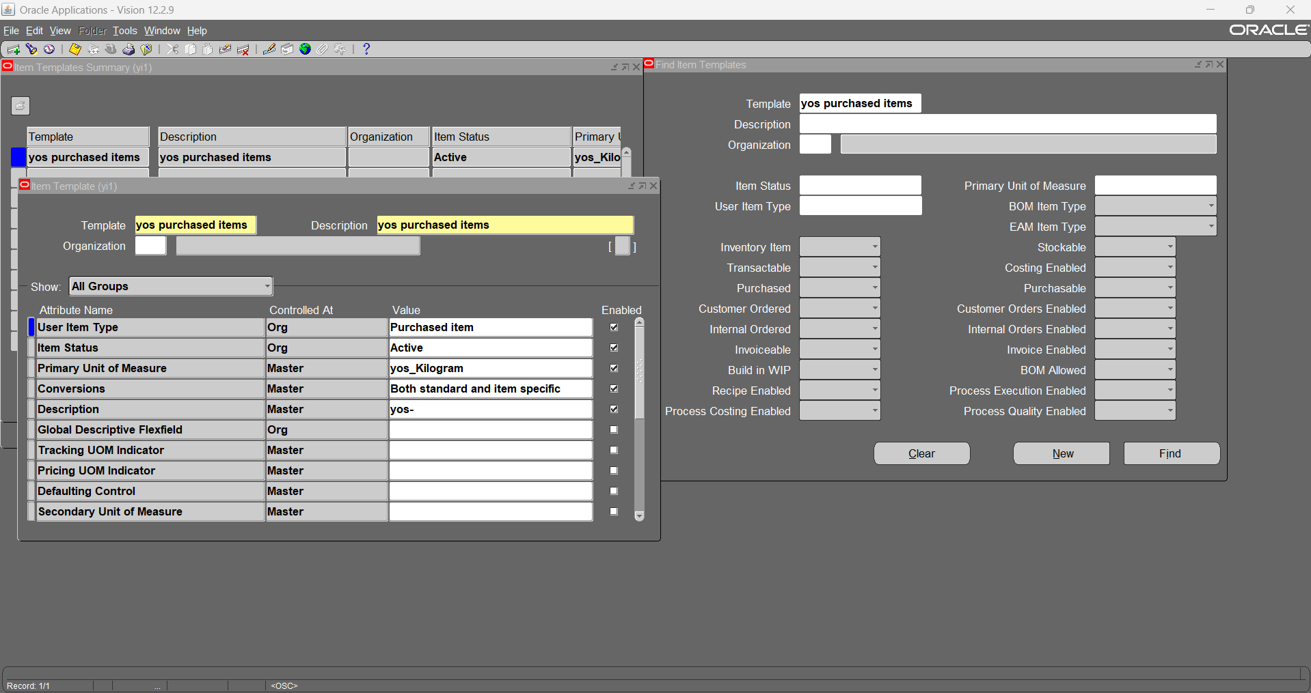
11.1- new item template

Slide 55
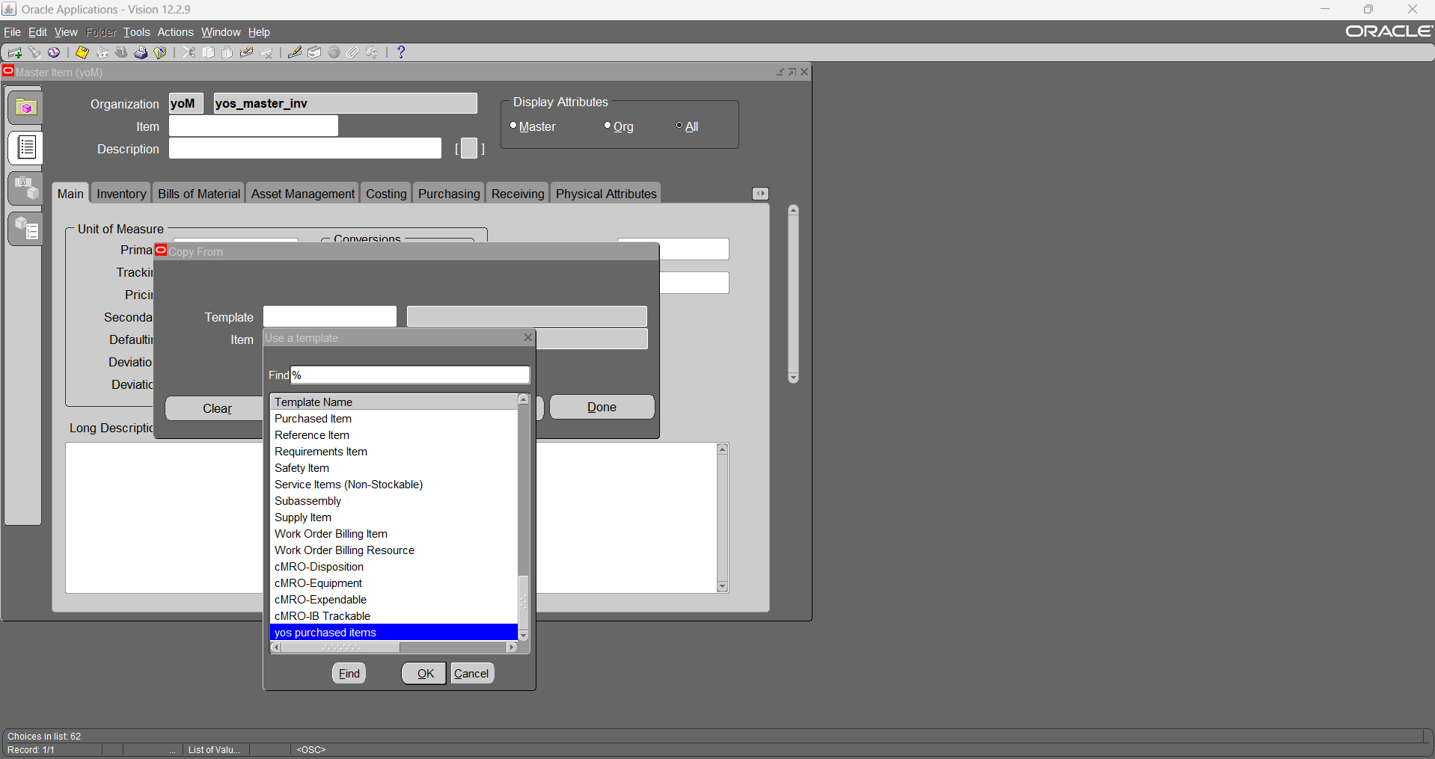
12- Create new Item (using copy from previously defined template & using previously defined UOM)

Slide 56
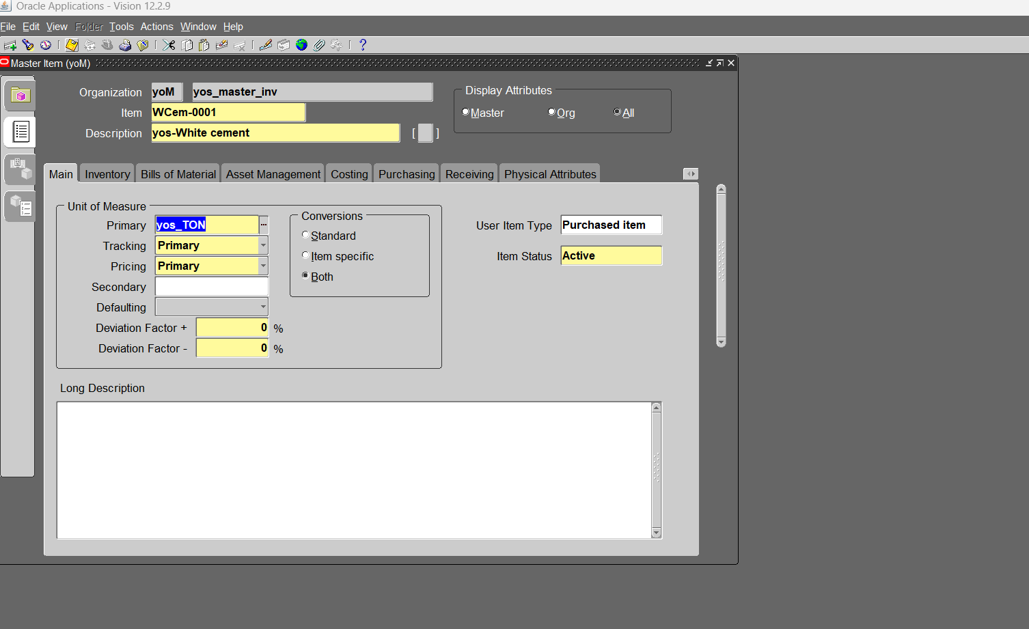
12.1- using previously defined UOM

Slide 57
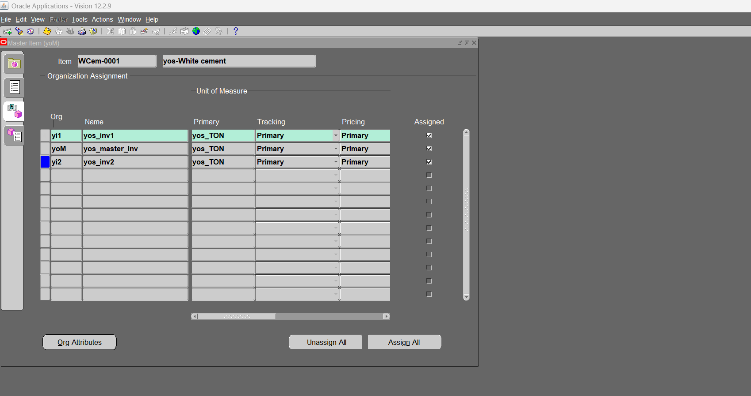
12.2- assign the new item to the inventory organizations

Slide 58
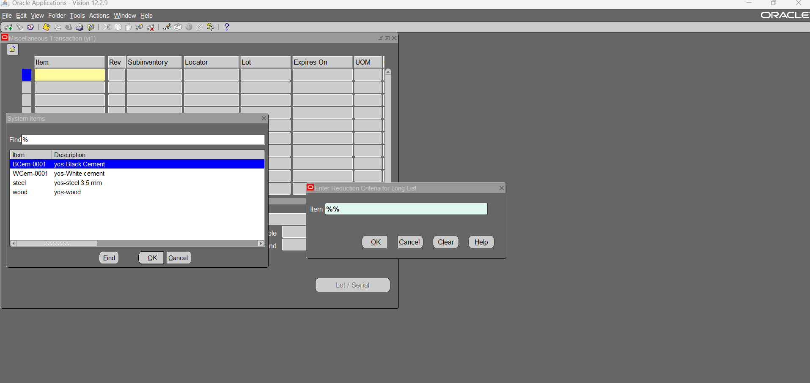
Miscellaneous transaction NO.2

Slide 59
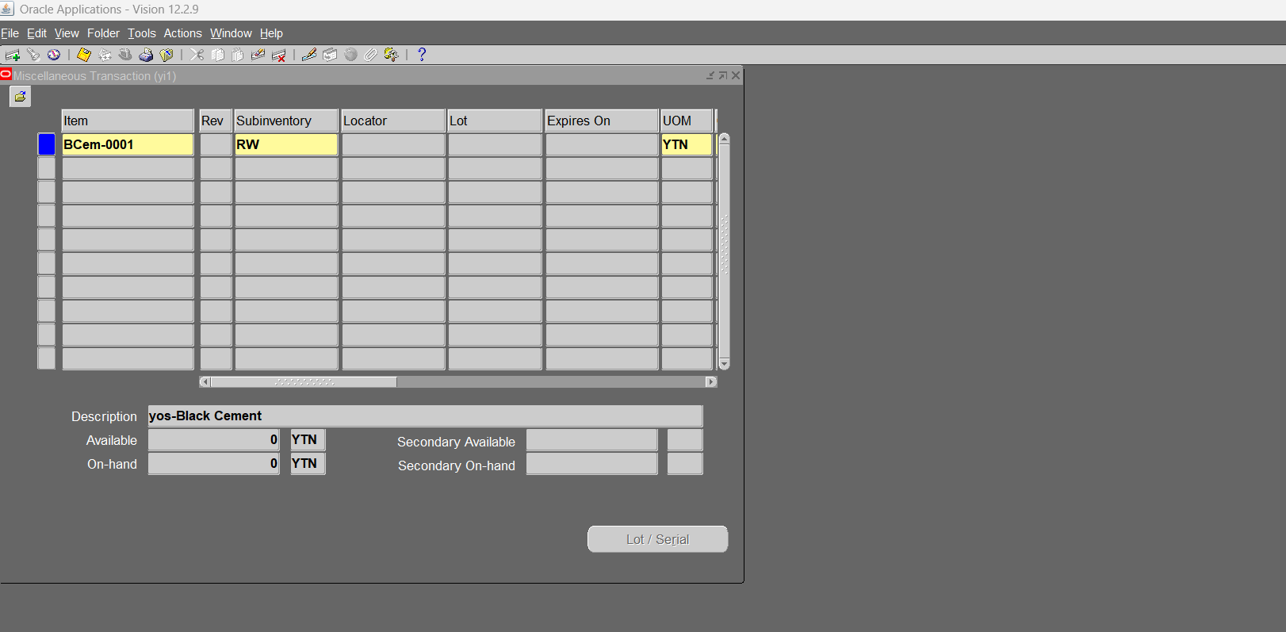
Miscellaneous transaction NO.2

Slide 60
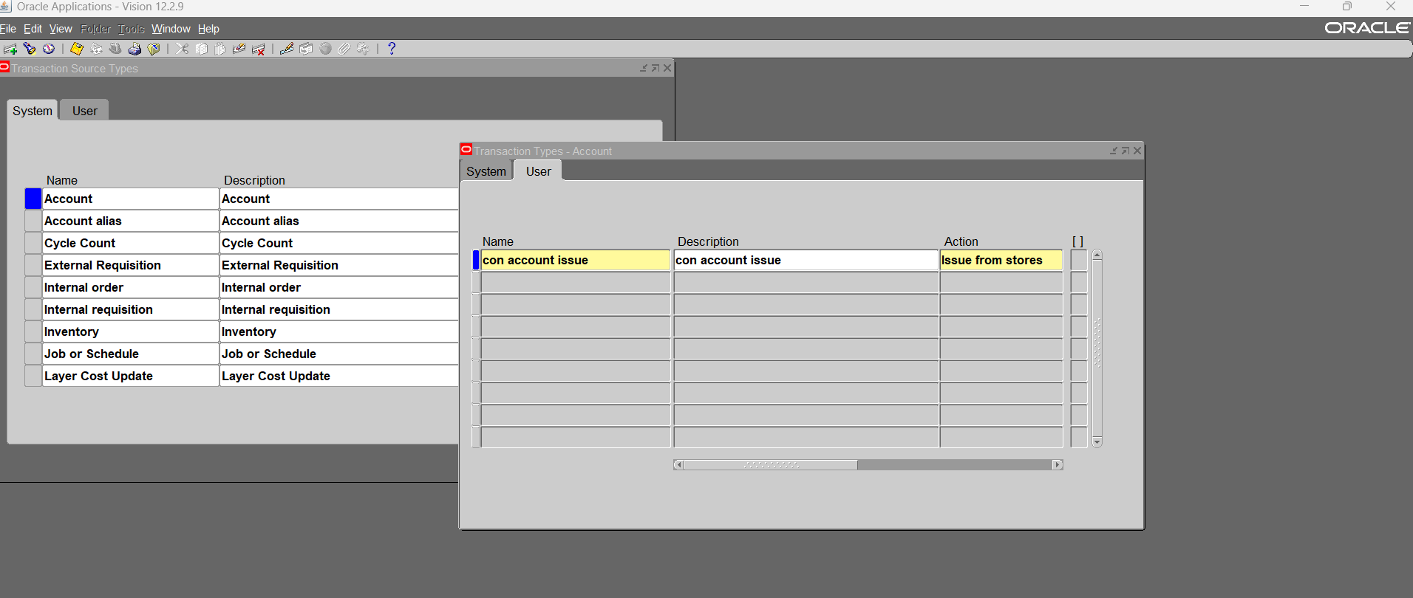
13- Create new transaction source type (account issue)- we cannot change selected account at source line the account stay fixed at each line and we can see it

Slide 61
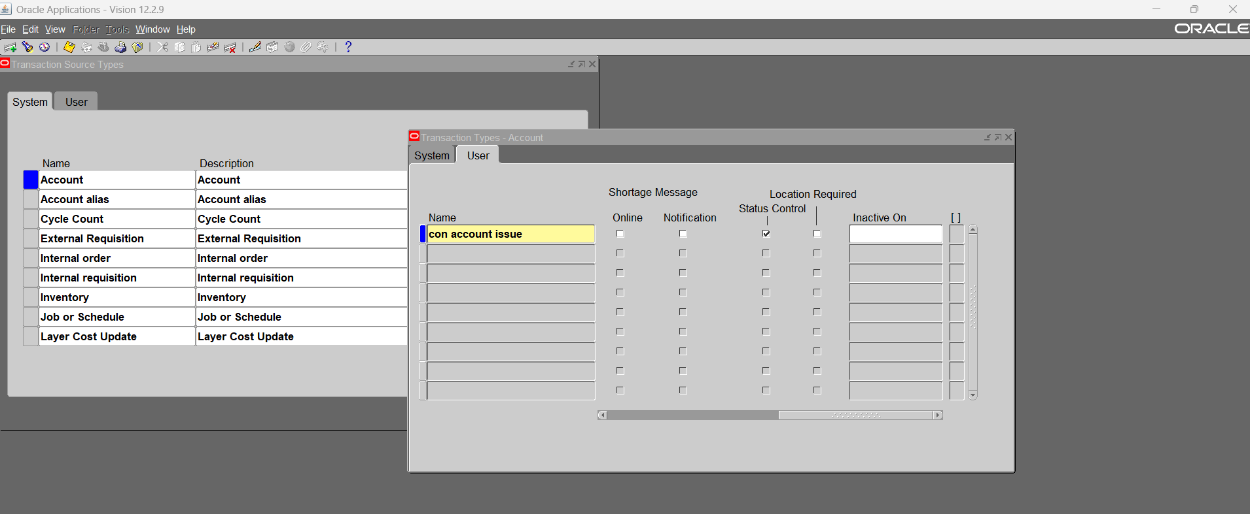

Slide 62
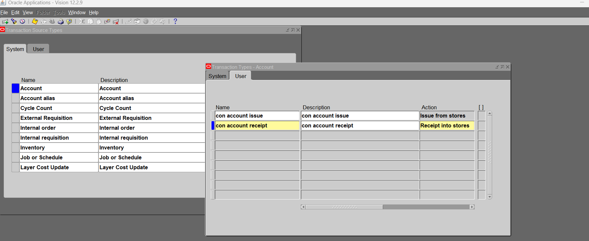
13.1- Create new transaction source type (Account receipt)

Slide 63
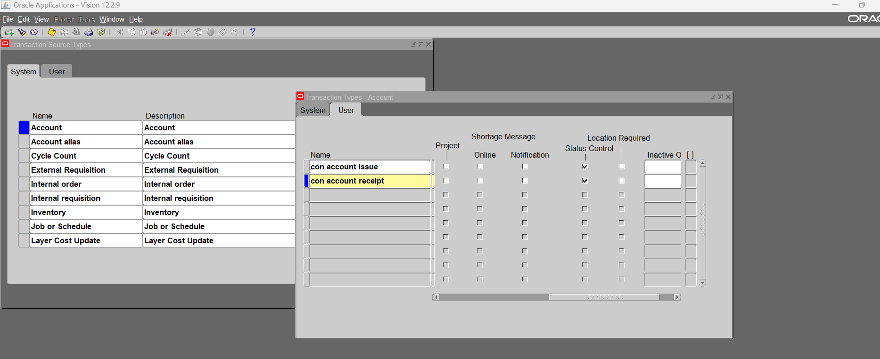

Slide 64
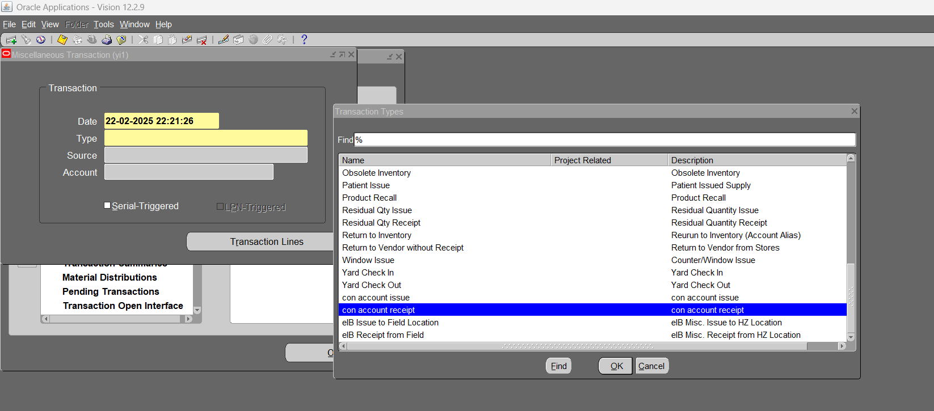
14- Create Miscellaneous transaction (using new transaction type con account receipt)

Slide 65
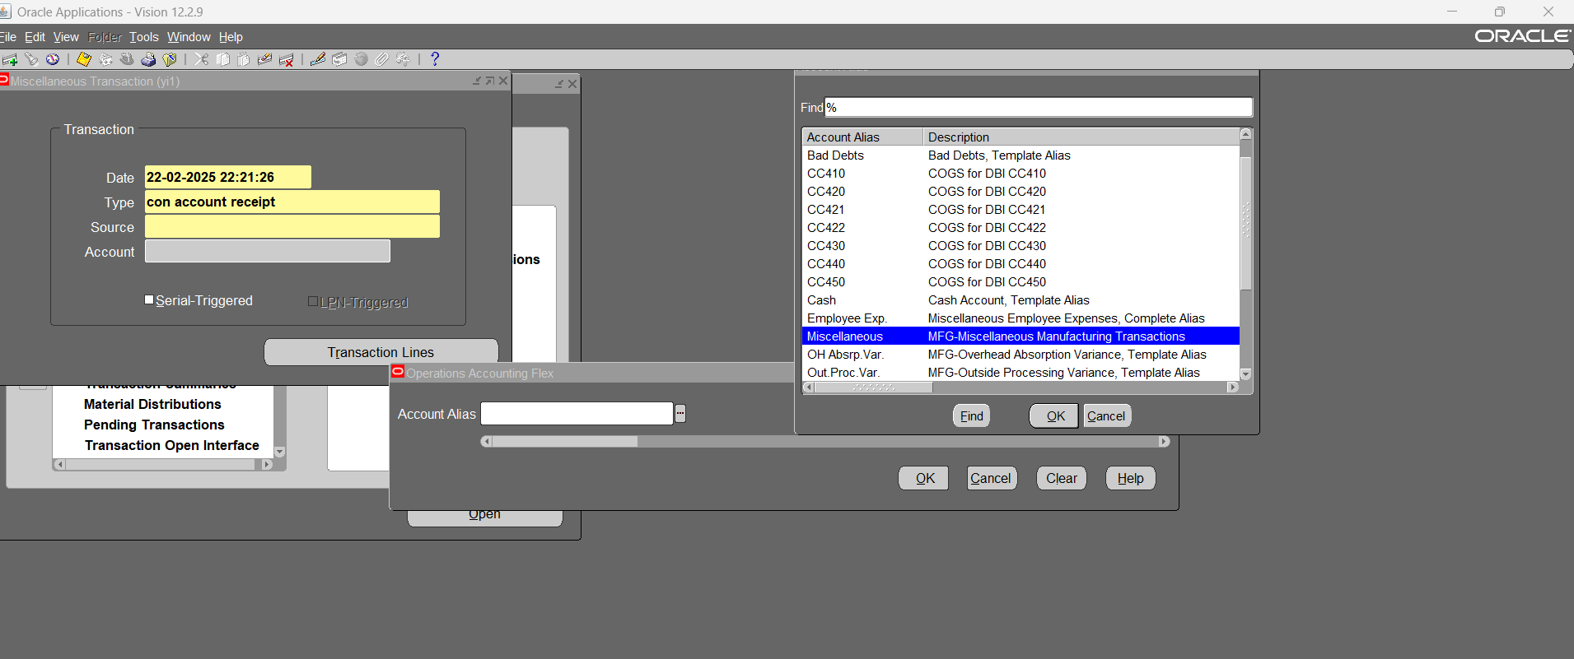
14.1- we choose account at source line

Slide 66

14.1-

Slide 67

14.1-

Slide 68

14.2- Receiving at locator control subinventory

Slide 69

14.2-Receiving at locator control subinventory

Slide 70

15- Adjust account alias key flexfield (To accept more characters) – Arabic character take a place of more the one character

Slide 71


Slide 72

15.1- run flexfield view generator request

Slide 73

16- Create new transaction source type (account alias issue & Receipt) - we cannot change selected account at source line the account stay hidden at each line in the transaction

Slide 74

16.1- Define new account aliases

Slide 75

16.1- choose account combination

Slide 76

16.1- choose account combination

Slide 77

16.1- choose account combination

Slide 78

16.1-

Slide 79

17- Miscellaneous transaction (using our new account alias)

Slide 80

17.1- account is hidden

Slide 81

17.2- account alias transaction type done

Slide 82

18- Form Personalization “Miscellaneous transaction” (make the reason mandatory for each transaction)

Slide 83

18.1- here we can change the value “column name”

Slide 84

18.2- here we made the reason mandatory

Slide 85

18.3- define new transaction reasons

Slide 86

18.4- Miscellaneous transaction (using new reasons)

Slide 87

18.4- reason appears at the transaction

Slide 88

19- Define item transaction defaults (Sub-inventory) – to use it at shipping, receiving, move order receipts.

Slide 89

19.1- Define item transaction defaults (Locators)

Slide 90

20- Define new shorthand Aliases (appears at account receipt, issue & miscellaneous receipt, issue only) - doesn’t appear at account alias receipt, issue

Slide 91

20.1-

Slide 92

20.2-

Slide 93

20.3-Miscellaneous transaction (using the new shorthand Aliases)

Slide 94

21- Define Process interval for Interface Managers & activating them. (Cost manager, Lot move transaction, material transaction, move transaction)

Slide 95

21.1- Activate managers (tools- launch manager)

Slide 96


Slide 97

21.2- After activation

Slide 98

22- Create new item (Lot Control - item)

Slide 99

22.1- lot control item received into warehouse

Slide 100

23- Create new item (Serial Control - item) – generate serial numbers

Slide 101

23.1- Miscellaneous transaction (for serial control item)

Slide 102


Slide 103


Slide 104


Slide 105


Slide 106


Slide 107


Slide 108

23.2- Serial Control item (Issue from store)

Slide 109


Slide 110

24- Create new item (Lot-Serial Control item)

Slide 111


Slide 112

24.1- Miscellaneous transaction (For Lot-Serial Control item)

Slide 113


Slide 114


Slide 115


Slide 116


Slide 117


Slide 118

24.2- run serial number transaction request

Slide 119


Slide 120

25- Create new transaction type (Sub-inventory transfer) – move items between Sub-inventories within the same inventory organization

Slide 121

25.1- Transaction (Sub-inventory transfer)

Slide 122


Slide 123


Slide 124


Slide 125

26- Move order transaction (request to transfer items between Sub-inventories within the same inventory organization )

Slide 126


Slide 127


Slide 128

26.1- allocate and transact move order

Slide 129


Slide 130


Slide 131


Slide 132


Slide 133


Slide 134


Slide 135

27- Define new employees (to use them as planners)

Slide 136

27.1- Inventory, setup, planners

Slide 137

27.2- Create new item (Item has specific planner)

Slide 138

27.3- Move Order transfer between sub-inventories (Require approval of the planner)

Slide 139

27.4- Planner approval

Slide 140


Slide 141


Slide 142


Slide 143


Slide 144

27.5- Print Move Order Pick Slip Report (Summarize Move Order transactions)

Slide 145


Slide 146

28- Create new inventory picking rule (inventory- setup- rules- picking)

Slide 147


Slide 148

28.1- Assign picking rule for the organization

Slide 149

29- Define Shipping networks between different inventory organizations (transfer type: intransit & Direct)

Slide 150

29- Define inter-organization transfer charge

Slide 151

29.1- transfer type: Direct (move items directly between different inventory organizations )

Slide 152

29.2- Inter-organization transfer (Direct transfer)

Slide 153


Slide 154

29.3- Define receiving options (To use them at intransit Inter-organization transfer)

Slide 155

29.4- Define financial options (for Operating Unit from purchasing modules)

Slide 156


Slide 157


Slide 158

29.5- Define purchasing options (for Operating Unit)

Slide 159

29.6- Define intransit transfer type (from yi2 to yi1) – (other inventory organizations should receive it from receipts)

Slide 160

30- inter-organization transfer transaction

Slide 161


Slide 162


Slide 163


Slide 164


Slide 165


Slide 166

31- Create new item (restricted Sub-inventory & restricted Locator item) – tools, item sub-inventories

Slide 167

32- Create new item (Revision Control item) - tools, revisions

Slide 168

32.1- Miscellaneous transaction (Receiving Revision Control item)

Slide 169


